Slide 1
Representando los cambios en las condiciones climáticas, provocada por El Niño a nivel nacional y subnacional.
Lino Naranjo.
Consortium of Capacity Building (CCB).
University of Colorado
Notes:
Thanks to Mr Wassila , thanks to Sezin and the Turkish Meteorological Service for give me the opportunity to be here tonight to expose some of our result that I think could be useful to some of you.
I know tomorrow is the final day of this meeting and there have been much information in a few days, so the very good news now is…I won’t use the 2 hours…
This morning I was listening some of your questions, and some of them, were about a very important issue, How we can use better all these forecast. Well, the answer is not easy, I don’t know yet. BUT what I am sure is the answer is in a multidisciplinary approach where social and sciences come together.

Slide 2
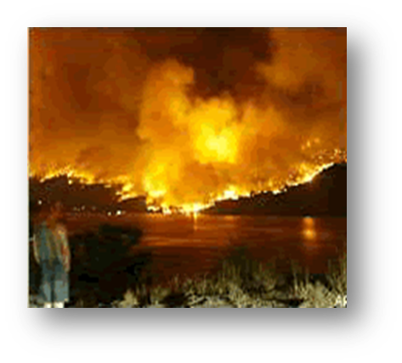
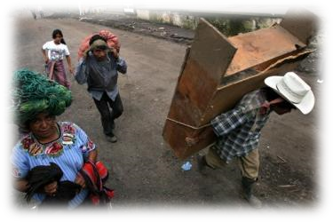

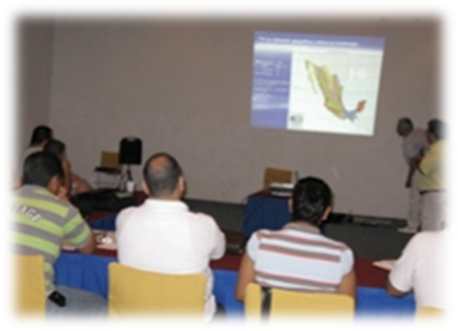
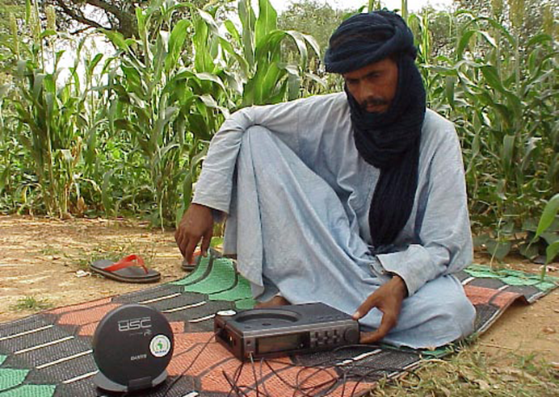
Este resultado es parte de un proyecto en curso llamado "Naciones listas para El Niño" que busca mejorar el valor de los Servicios Meteorológicos e Hidrológicos Nacionales (SMHN) en las sociedades. (http://elninoreadynations.com/)
La “Nación preparada para El Niño” se centra en un concepto multidisciplinario de El Niño que involucra cuestiones de ciencia, impactos, políticas, economía, ética y equidad.
Mapeo del "Clima de El Niño": Estudiamos la capacidad de El Niño para perturbar el clima regional "normal" en todo el mundo con el fin de aumentar el conocimiento y apoyar los esfuerzos de Reducción del Riesgo de Desastres (RRD) y la preparación estratégica para los riesgos hidrometeorológicos relacionados.
El concepto de naciones preparadas para El Niño (ENRN) es parte del concepto más amplio de“Weather ready nation” (https://www.weather.gov/wrn/).”
Notes:
This result is part of an ongoing project, funding by OFDA, named “El Niño-Ready Nations” that seeks to enhance the value of National Meteorological and Hydrological Services (NMHSs) in societies
“El Niño-Ready Nations” is more than a name, it is a concept created by the Dr. Michael Glantz from the Consortium of capacity Building at Colorado University. In this sense An “El Niño-Ready Nation” search for proactive actions focused on a multidisciplinary concept on El Niño that involves science, impacts, policy, economics, ethics & equity issues). The concept of El Niño ready nations (ENRNs) is part of the broader concepts of “Weather ready nation”.
One of the main task was the mapping of “El Nino Climate” , study of El Niño and its capacity to disturb the “normal” regional climate worldwide, in order to increase knowledge and support the Disaster Risk Reduction (DRR) efforts and strategic preparedness for related hydro-meteorological hazards.
More information about El Nino Ready Nation can be found in the web address indicated in the slide

Slide 3
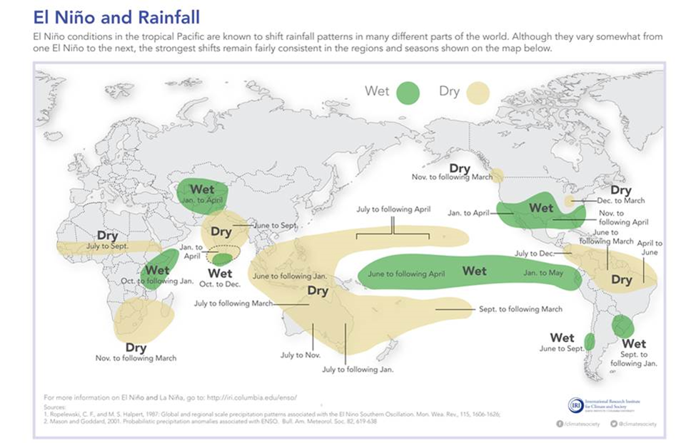
Los mapas relacionados con El Niño, que ilustran la información sobre los impactos, son importantes fuentes de conocimiento y herramientas para los tomadores de decisiones, que buscan aumentar su conocimiento sobre los peligros esperados durante El Niño.
Sin embargo, una cuestión importante es capturar la magnitud de los cambios a escala nacional o subnacional, a fin de establecer una imagen más realista e integral de los impactos.
Notes:
Usually, when working with El Nino impacts, we use those traditional impacts map some of them are versions of the first map designed by Ropelewski and Halpert in the 80s.
Actually, El Niño impact maps are important sources of knowledge for decision makers. However sometime this information not enough to capture changes at the national or subnational scales. This issue constitute one of the main challenges along with forecasting uncertainty.

Slide 4
¿Cómo podemos obtener mapas de impacto de El Niño más utilizables a nivel regional, nacional o subnacional?
Las principales debilidades de la visión tradicional son:
Los impactos sobre una región o país generalmente no son uniformes y tienden a concentrarse en áreas muy localizadas.
Además, las interacciones de la teleconexión de El Niño con otros patrones de circulación regional crean una gran variabilidad de los impactos.
Estos hechos, junto con las incertidumbres actuales en el pronóstico de El Niño, imponen restricciones importantes a las acciones de los SHMNs y al desarrollo de políticas adecuadas de RRD.
Notes:
It is evident, that a Project seeking to highlight the value of using El Niño climate information for decision making, has to take care about this important issue: How we can get El Nino impact maps more usable at regional, national or sub-national levels?.
So what are the main weaknesses of the traditional view of El Nino Impacts maps?
Impacts over a region or country usually are not uniform, and tend to be concentrated in very localized areas.
Interactions of El Niño teleconnection with others regional circulation patterns create a strong variability of the impacts over certain areas.
These facts along with the current uncertainties in El Niño forecast impose important constraints to the NHMSs actions and the development of adequate DRR policies.

Slide 5
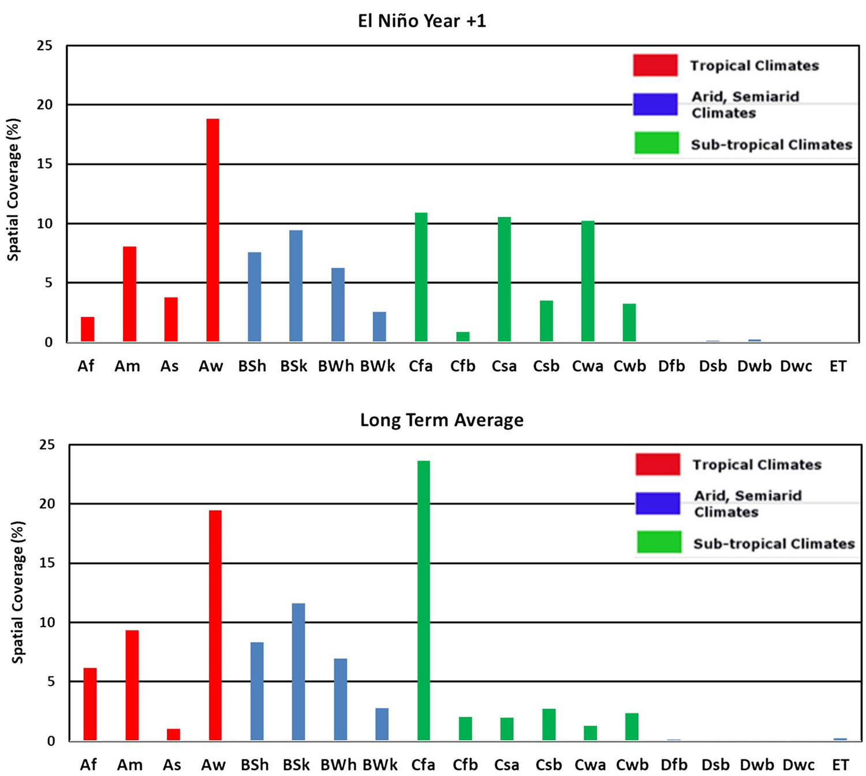
Marco conceptual de la metodología de mapeo.
La idea detrás de esta metodología fue establecida en primer lugar por el Dr. Michael Glantz Director del Consortium of Capacity Building. Universidad de Colorado.
Considera que los impactos más significativos de El Niño dejan una "huella" en el clima normal (e.g. previsible) de una región y país, creando un clima "nuevo" o "perturbado" que se puede visualizar utilizando el sistema de clasificación de Köppen-Geiger
Distribución de cobertura espacial promedio de los subtipos de Koppen-Geiger para El Niño Año +1 (panel superior) y promedio a largo plazo (panel inferior). América Central y el Caribe (Naranjo et. al 2018)
Al comparar los mapas climáticos "normales" con los nuevos mapas climáticos considerando El Niño, podemos describir un marco realista de esos posibles impactos significativos y su variabilidad espacial y temporal. Esto también nos permite estimar frecuencias y generar mapas de riesgo.
Notes:
The idea behind this methodology was firstly established by Dr, Michael Glantz Director of the Consortium of Capacity Building.
It considers that the more significant El Niño’s impacts should leave a fingerprint on the normal climate of a region and country, creating a “new” or “disturbed” climate that can be visualized using the Köppen-Geiger classification system. So, comparing the “normal” climate maps against new climate maps considering El Niño, we can describe a realistic pictures of those potential impacts and their spatial and temporal variability. This also permit us to estimate frequencies and generate risk maps.
In the figure we are presenting some of the previous result we got searching for these “signals”. These figure represent the spatial distribution of the main climate types for the region of the Caribbean Sea, Central America and South of the United Sates (Tropical (Red), Subtropical (green) and Arid (blue). For a long term average (50 years) lower panel and for 9 El Nino events upper panel. What seems clear is that during El Nino events there are a significant re-ordering in the spatial coverage of many sub-types. So, we can conclude that some areas into the region underwent climate shifts.
This approach has important innovative characteristics such as providing information, not only about the direction of change in a climate regime, but also indicating magnitude of change. These changes have devasting and long-lasting consequences on economy, agriculture, food insecurity, public health, and human welfare.

Slide 6
¿Por qué utilizar el sistema de clasificación climática Köppen-Geiger?
Por su simplicidad: utiliza las estadísticas de temperatura y precipitación en la clasificación del clima. Estos dos elementos climáticos son fáciles de medir. Requiere una cantidad mínima de cálculo.
La temperatura y la precipitación son los elementos climáticos que afectan nuestro entorno físico más directamente que cualquier otro.
Se basa en parámetros estadísticos; cada región climática se puede definir con precisión utilizando un código abreviado de letras para los tipos climáticos.
Existe una correlación razonable a nivel mundial con las principales regiones de vegetación.
Alternativamente, nuestra pregunta podría plantearse como: ¿es la señal de El Niño lo suficientemente fuerte como para modificar la clasificación climática de Köppen-Geiger de una región? Esta pregunta es importante en términos de preparación para los impactos (y, por lo tanto para la RRD).
Notes:
The main reason why we used the Koeppen classification, in our study, was its simplicity ,among others accepted climate classification. It uses the temperature and precipitation statistics in classification of the climate. These two climate elements are easy to measure and requires a minimum amount of calculation.
Classification of the climate, is based on statistical parameters, each climatic region can be defined using a shorthand code of letters for the climatic types. All the major climate groups, sub-groups, and further subdivisions are described by a combination of letters making it very simple.
These elements ,affect other aspects of our physical environment more directly than any other element. Obviously, the system of classification devised by Koppen is directly related to many others aspects of natural environment (vegetation).
Alternatively, our question could be stated as: is an El Niño signal strong enough to modify the Köppen-Geiger climatic classification of a region?

Slide 7
Clasificación climática de Köppen-Geiger 101
La clasificación climática de Köppen divide los climas en cinco grupos climáticos principales, y cada grupo se divide según los patrones estacionales de precipitación y temperatura.
Tercera letra (patrones de temperatura)
h ………..T_{ann} árido caliente ≥ +18 ° C
k ………..T_{ann} árido frío <+18 ° C
a ………..verano caluroso
b ………..verano cálido
c …………verano fresco
d …………verano frío
Primera letra (Grupo climático principal)
A clima tropical ...... Tmin ≥ +18 ° C
B Clima seco ………… Pann <10 Pth
C Templado moderado… -3 ° C <Tmin <+18 ° C
D Continental (nieve) .. Tmin ≤ -3 ° C
E Polar …………………… .. Tmax <+10 ° C
Gpt
Los subgrupos dentro de los cinco grupos principales son:
S - Clima estepario: clima semiárido
W - Clima del desierto: clima árido
Las letras S y W se aplican solo a los climas secos B, produciendo dos combinaciones: BS y BW.
Segunda letra (precipitación estacional)
f ... Totalmente húmedo (sin estación seca)
m ... Monzón
w ..... Invierno seco.
s ...... Verano seco
T_{min} …. Valor mínimo mensual para todo el año. P_{th} …. Umbral de sequedad.
P_{ann} …… Precipitación media annual T_{ann} …Temperatura media anual
Notes:
The Koppen Geiger classification create a code of letters to design major climate groups, sub-groups.
Five major climate groups are designated by capital letters as follows:
A–Tropical Rainy Climate: Average temperature of every month is over (18oC). Annual rainfall is large and exceeds annual evaporation.
B–Dry Climate: Potential evaporation exceeds precipitation throughout the year. No water surplus.
C–Mild Temperate Climates: Coldest month has an average temperature under (18oC), but above -3oC; at least one month has an average temperature above 10oC). The sea climates have both a summer and a winter season.
D– Snowy (Continental) Climates: Coldest month has an average temperature under -3oC. Average temperature of warmest month is above 10oC
E–Polar Climates: The average temperature of warmest month is blow 10oC. The climates have no true summer.
Four of these five groups (A, C, D and E) are defined by the temperature averages, whereas one (B) is defined by the precipitation to evaporation ratios.
Sub-Groups
Sub-groups within the five major groups are designate by a second letter, according to the following codes:-
S – Steppe Climate: A semi-arid climate with about 15-30 inches (38-76 cm) of rainfall annually at low latitudes.
W – Desert Climate: Arid climate. Less than 10 inches (25 cm) of rainfall annually.
The letters S and W are applied only to the dry B climates, yielding two combinations – BS and BW.
Second Letter (Seasonal Precipitation)
f:- Moist. precipitation in all months. No dry season. This modifier is applied to A, C and D groups, creating combinations – Af, Cf and Df.
w:- Dry season in the winter of the respective hemisphere. This modifier is applied to A, C and D groups, yielding combinations – Aw, Cw and Dw.
s:- Dry season in the summer of the respective hemisphere (high sun season).
m:- Mosoon climate. Short, dry season. Applies to only A climates (Am).
To differentiate more variations in temperature, Koppen added a third letter to the code group. Meanings are as follows:
Thirds letter (Temperature patterns)
a: With hot summer; warmest month over 22oC. Used for C and D climates.
b: With warm summer; warmest month below 22oC. Used for C and D climates.
c: With cold, short summer; less than 4 months over 10oC. Used for C and D climates.
d: With very cold winter; coldest month below –38oC. Used for D climates only.
h: Dry, hot; mean annual temperature over 18oC. Used for B climates only.
k: Dry, cold; mean annual temperature under 18oC. Used for B climates only.

Slide 8
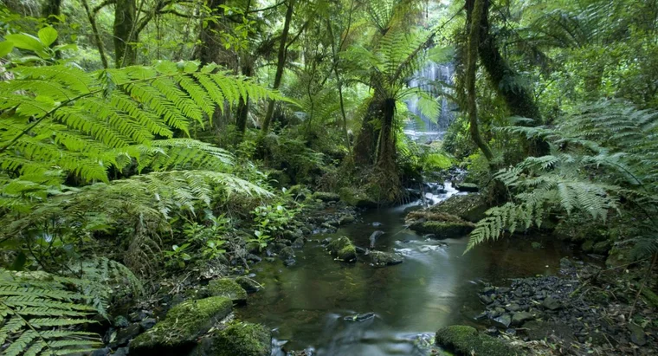

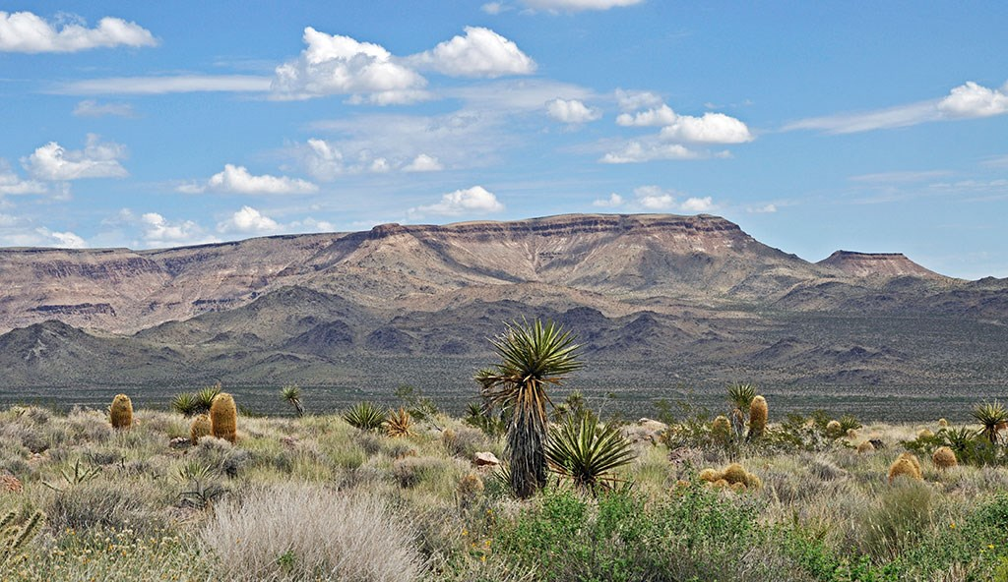
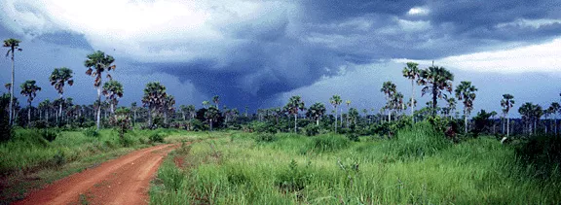
A_{f Bosque tropical}
BW_{h Desierto caliente}
Aw Sabana tropical con invierno seco.
BSh Caliente semiárido (estepa)
Notes:
From the combination of the letter groups, distinct climates emerge. As examples.
Af called Rain forest climate where rainfall of the driest month is 60 mm or more. These climates usually occur within 10° latitude of the equator. This climate is dominated by the intertropical low-pressure system all year round, so has no natural seasons in terms of thermal and moisture changes.
Aw It is the Tropical Savannah with dry winter.. At least one month has rainfall less than 60 mm and less than 4% of the total annual precipitation.. The dry season is strongly developed. As is used in place of Aw if the dry season occurs during the time of higher sun and longer days (during summer.
BSh Hot semiarid or Steppe Climate: A semi-arid climate characterized by grasslands. It occupies an intermediate position between the desert climate “BW” and the more humid climates of A, C and D groups.
BWh . Is the Hot Desert Climate with the annual precipitation below the 50% of the certain limit and average annual temperature above 18 °C. (the coldest month has an average temperature above 0 °C. .

Slide 9
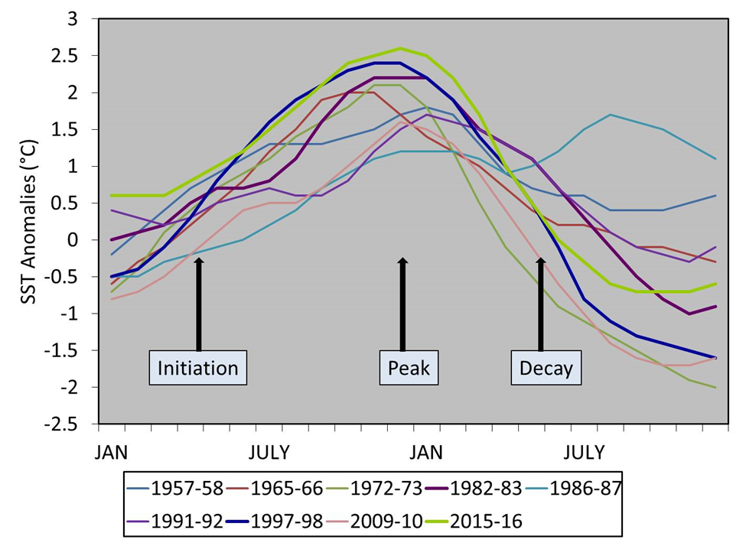
El inicio y la decadencia de El Niño es en realidad un ciclo trans-anual.
Si bien la convención de usar el año calendario (enero a diciembre) para definir a El Niño es útil por simplificación, no es una descripción precisa del ciclo de vida de El Niño.
La temporada de verano del HN puede considerarse un "punto de partida" en términos de respuestas gubernamentales e institucionales a un pronóstico de El Niño, porque en esta temporada la capacidad de los modelos de predicción es cada vez mejor después de la llamada "barrera de la primavera"
Definimos un Año de El Niño como un período de 12 meses que comienza en julio del primer año calendario (inicio del evento) hasta junio del siguiente año calendario (Año +1, fin del evento).
Notes:
The onset and decay of El Niño is actually a cross-annual cycle.
All Climate classification are based on the usual Calendar Year (January-December) , However El Niño events are a cross-annual event typically lasting 9 to 12 months. El Niño events tend to develop during Spring (March-June of the Northern Hemisphere), reach peak intensity during the late autumn or winter (November-February), and then weaken and return to neutral conditions during late spring or early summer (March-June) of the following year.
IN term of impacts most of El Niño impacts on the regional or national climate occur in the NH winter of the First Year and spring of following Year, where teleconnection patterns are more fully developed and stronger in the higher latitudes. Additionally the summer season could be considered a “starting point” in terms of institutional responses to an El Niño forecast, because in this season the ability of the prediction models becomes increasingly better after the so called “Spring Barrier”.
So in our approach, we define an El Niño Year as a 12-month period that begins in July of the first calendar year (onset of the event) and ends in June of the following calendar year. For example, to construct the 1982-83 El Niño non-calendar year, it is necessary to consider a 12-month period from July 1982 to June 1983.

Slide 10
Cálculo de las clases de Köppen y clasificación de los cambios climáticos durante los años de El Niño
1.0. Adquisición de datos. (construcción de datos de alta resolución)
2.0. Lectura y procesamiento de datos.
2.1.Construcción de matrices y entradas para el cálculo de Köppen normal
2.2. Construcción de matrices y entradas para el cálculo de Köppen para el año promedio de El Niño
3.0. Cálculo del mapa Köppen "normal"
3.1. Cálculo del mapa Köppen El Niño
4.0. Cálculo de los cambios climáticos
Notes:
The calculations of El Niño Köppen-Geiger classification and shifts are based on two separate processing:
Calculation of the long-term average Köppen-Geiger classification for the nation or region. It is recommended to consider a 30-year or more data series.
Calculation of El Niño Köppen-Geiger classification shifts for the nation or region. El Niño year is constructed taking a 12-month period from July Year 0 to June Year +1.
In Slide we present a flow chart of the steps needed to calculate the climate shifts. Steps 1.0 and 2.0 refer to the data acquisition process which depends on the availability of reliable sources and the existence of processing tools. Once the data set have been selected, two separate steps are developed: the definition of the El Niño dataset (Steps 2.1 and 2.2) which means process a subset with all El Niño years into the sample and the long-term range averages based on at least 30 years of data. Steps 2.1 and 2.2 represent the processing of separate datasets to create data matrixes suitable to perform the Köppen-Geiger classification and obtain maps of Köppen-Geiger categories (Step 3.0) for each sample. Comparing results from El Niño and the long-term average data enables us to create maps depicting climate shifts (Step 4.0).

Slide 11
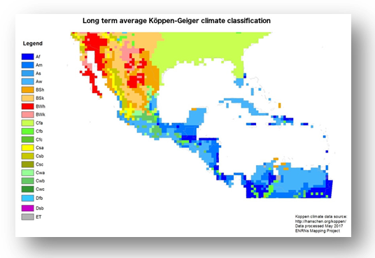
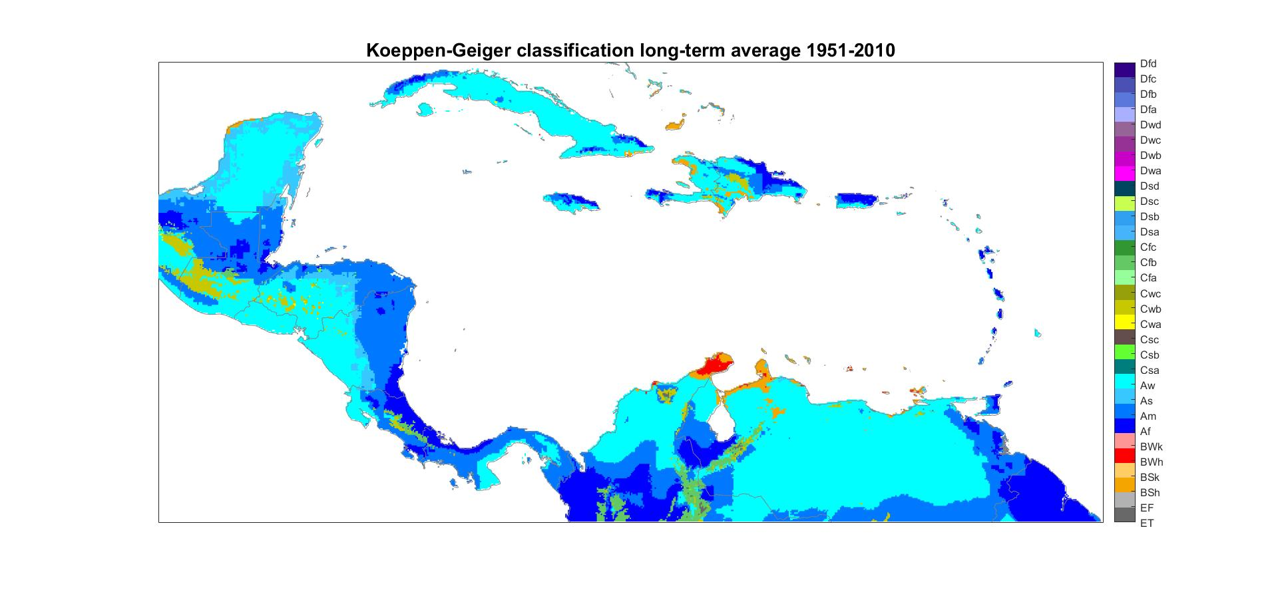
El cálculo de los tipos climáticos de Köppen-Geiger y los cambios asociados con El Niño dependen de la existencia de conjuntos fiables de datos mensuales de lluvia y temperatura con resoluciones espaciales y temporales adecuadas.
Precipitación terrestre: series temporales mensuales situados por coordenadas. 1900-2017
Departamento de Geografía de la Universidad de Delaware. Datos de varias fuentes interpolados en una cuadrícula de 0.5 ° de longitud × 0.5 ° de latitud. (http://climate.geog.udel.edu/~climate/html_pages/download.html)
Precipitación infrarroja del grupo de riesgos climáticos con datos de estaciónes (CHIRPS) Desde 1981 hasta el presente, CHIRPS incorpora imágenes satelitales de resolución de 0.05 ° con datos de la estación in situ para crear series raster de lluvia.
Conjuntos de datos nacionales de alta resolución: INSIVUMEH ((INSTITUTO NACIONAL DE SISMOLOGÍA, VULCANOLOGIA, METEOROLOGÍA E HIDROLOGIA de Guatemala) desarrolló un conjunto de datos de temperatura de muy buena resolución (500X500 mts.) De Guatemala.
Notes:
A big challenge is that almost all long-term global data sets have resolutions that at the regional, national, and subnational scales seems too low. So, in a “Perfect Word”, we expect that NHMSs can develop to their own reliable high resolution data. However, in the Real Word, observational networks, with long-term climate data, are very scarse in those regions and countries that are particularly vulnerable to El Niño’s impacts. WE have to take in account that as El Nino has a multiyear frequency so we need not only reliable but also long enough data sets.
In this work , we initially used the Terrestrial Precipitation and Temperature:1900-2017 Gridded Monthly Time Series Department of Geography University of Delaware. Global observational dataset, which combines data from several sources interpolated onto a 0.5 ° longitude × 0.5 ° latitude grid.
However, although resolution is aceptable for the use of big áreas, it is a very low resolution for its use to a National Level.
Seeking to improve previous results, using estimated higher resolution data, we tried Climate Hazards Group InfraRed Precipitation with Station data (CHIRPS), a quasi-global rainfall dataset with a 0.05° resolution. One important issue is they have not developed yet in a operational way a similar temperature data set, so it is necessary to combine with other temperatures data as we did in Guatemala. In case of there is no available temperature data you might use a high resolution climatology (such as in www.worldclim.org/) in this case, this mean temperature will be an invariant and any shift will be due only to precipitation regime. This kind of approximation would be valid in the Tropical belt.

Slide 12
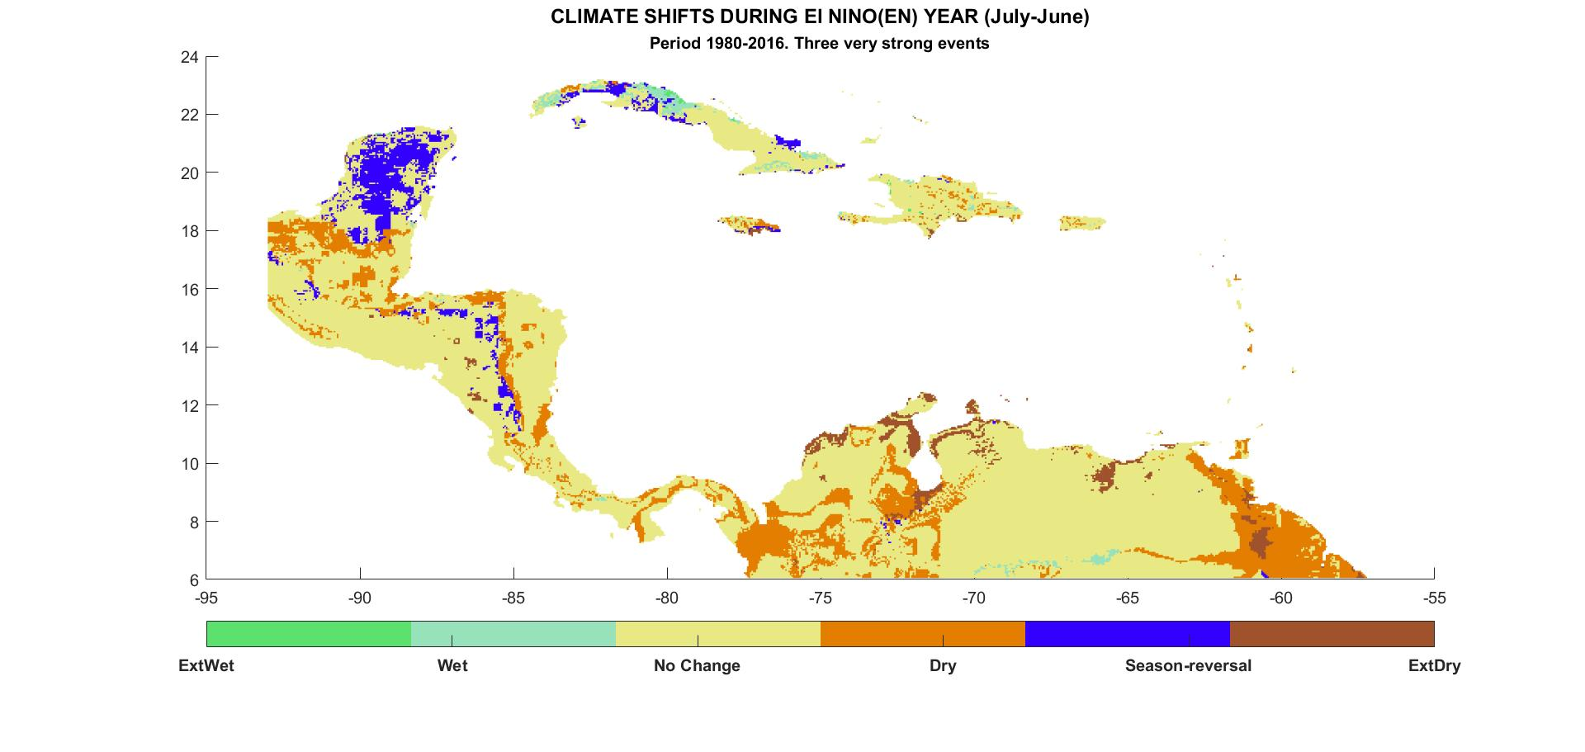
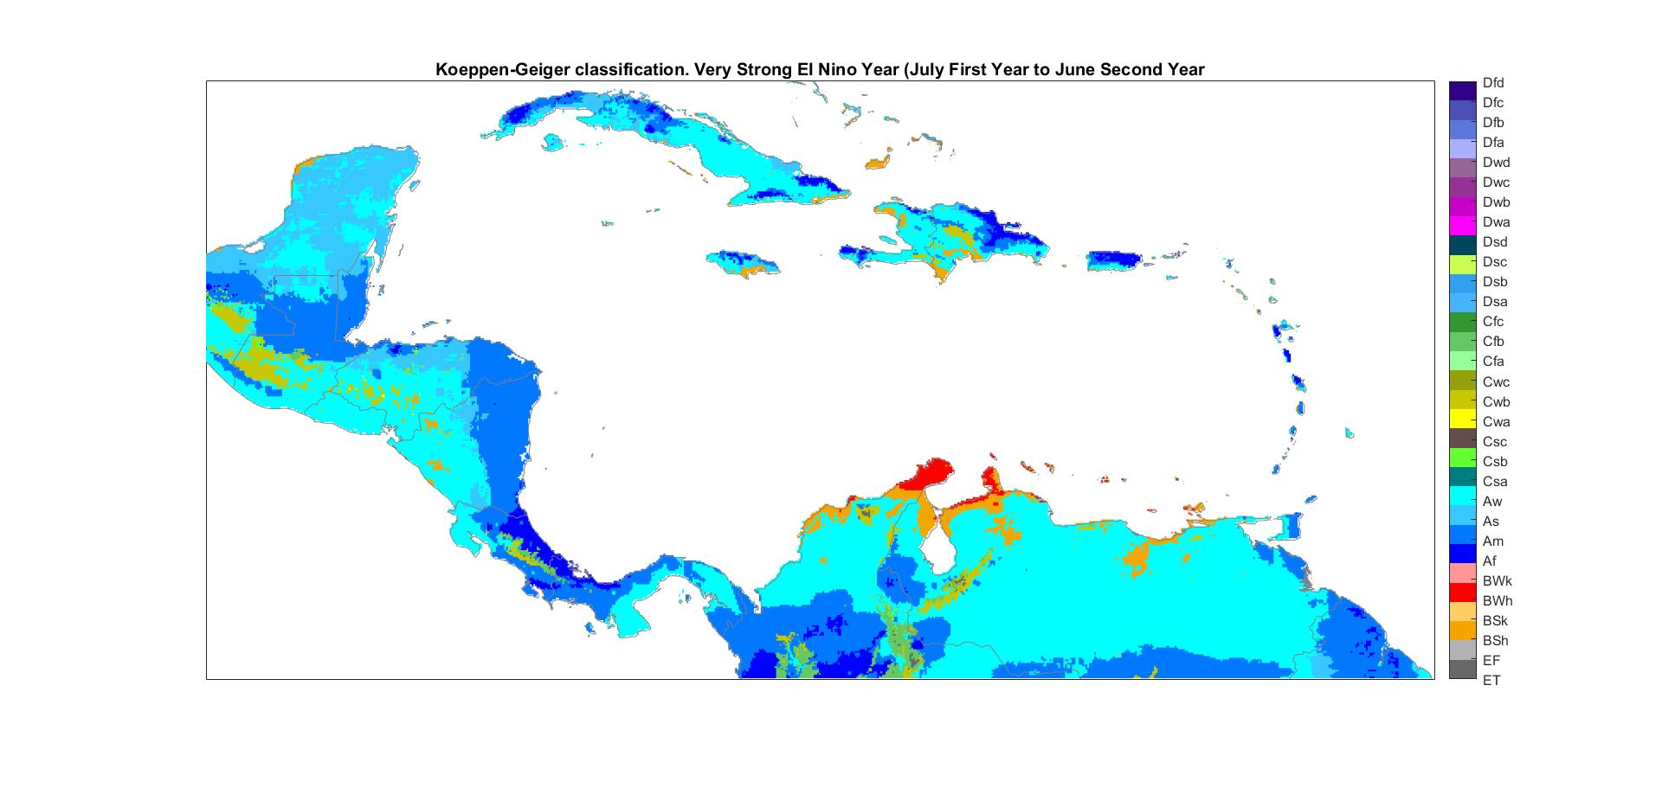
Cálculo de los cambios climáticos durante los años de El Niño
Crear dos mapas Koeppen. Un mapa a largo plazo o normal
y otro considerando solo los años El Niño.
Matriz de datos de largo plazo
Matriz de datos de los años de El Niño
Mapas de cambios
Qué significa eso. ¿Más seco, más húmedo?
Af Clima en este punto
Cambió para ser Am
Notes:
Once the data set has been defined the calculations of the shift is a very straightforward task using a matrix manipulation and processing as MATLAB or OCTAVE.
Basically method is simple
1. Using data of temperatue and precipitation we calculated two Köppen maps: A “Normal” Köppen map and El Niño Köppen maps.
2. To calculate El Niño Köppen maps, you should use only the available El Niño years, e.g. [1982 1997 1986 2002 2009…..2015].
3. To Calculate a climate shift due to El Niño impacts , Matrix with “Normal” Koeppen Values is subtracted from El Nino Koeppen matrix into the defined geographical area. As output, a map with the nature of the changes will be displayed. The matrix “C” with the numerical code of the changes should be saved in a file.
4- 5 Although the method seems to be simple, to obtain the shifts map it require a logical analysis on what do the observed changes mean. For example if in a certain point a we detected a shift Am to Aw. What does it mean??

Slide 13
Tipología de cambio climático de El Niño basada en la clasificación Köppen-Geiger. (Vista simplificada)
1.1
A_{m}
A_{w}
Grupo 1: Los cambios más significativos ocurren sobre el régimen de precipitación.
1.1. Cambia hacia un clima más seco
1.2. Sequedad severa, condiciones probables de sequía.
1.3. Cambia hacia un clima más húmedo
1.4. Cambia hacia un mayor contraste entre las estaciones húmedas y secas
1.5. Cambio hacia una reversión estacional en el mes mínimo de lluvia
Grupo 2: Cambios que son más significativos en el régimen de temperatura.
2.1. Cambios hacia un clima más cálido.
2.2. Cambios hacia un clima más frío.
Fuente: Naranjo et al. 2018
A_{w}
BS_{h}
1.2
1.3
A_{w}
A_{m}
1.4
C_{fa}
C_{sa}
1.5
A_{w}
A_{s}
C_{wb}
C_{wa}
2.1
BS_{h}
BS_{k}
2.2
Notes:
To give a more simplified view, based on the nature of the observed Köppen-Geiger climate shifts during El Niño, we developed a classification focused on the result of what a shift means in terms of “drier” and “wetter” or “cool” “warm” climate types . The classification is divided into two main groups by type of climate shifts and of subtypes.
Group 1 Includes climate shifts where the most significant changes occur over the precipitation.
This includes three types of the traditional “wet to dry” impacts (1.1, 1.2 1,3) but with other two giving information about seasonal 1* One example is the climate shift from Tropical Monsoon (Am) to Tropical Savanna (Aw). The most significant characteristic is a reinforcement of the dry season, which is clearly a shift to a drier climate (type 1) .
2*Two types of climate shifts are related to changes in the seasonal regime: 1.4 “ shift towards an increased contrast between the wet and dry seasons” and 1.5 “a shift towards a rainfall seasonal reversal in the rainfall minimum month”. The first of these two types indicates changes that are not necessarily linked to a drier or a wetter climate, but are related to changes in rainfall in one or more seasons that increase the seasonal contrast between the wet and dry seasons. 3* One example is the climate shift from Humid Subtropical (Cfa) to Mediterranean (Csa) in this shift, the very stable Humid Subtropical climate changes when anomalous rainy conditions appears in the winter season, this is a typical change in the SE of the Unites States.
“Seasonal reversal” appears when the monthly rainfall minimum, usually defined into the dry season shift toward one month of the rainy season. In savanna climate a seasonal reversal means a shift from Aw type to As (savanna with a dry summer) or vice versa.
Causes that lead to a seasonal reversal could be: Abnormally heavy rains the winter season followed by a dry summer ( which seems to be case of the Western Cuba) or an extremely dry summer or canicula with drought condition as is the case in the “Dry Corridor” area of Central America.
Group 2 . More common in High and Middle latitudes, In tropical areas tends to be concentrated in the continental highlands. This group is composed of two types of climate shifts. The first is a “cool to warm” type, for example we can found a climate shift from Subtropical Highland (Cwb) to Monsoon-influenced Humid Subtropical (Cwa), in the mountainous areas of Guatemala. The second is a “warm to cool” type. An example is the climate shift from Hot Semiarid (Bsh) to Cold Semiarid (Bsk), which is basically due to the abnormal irruption of cold air masses that are found in the semiarid areas in northern Mexico.

Slide 14
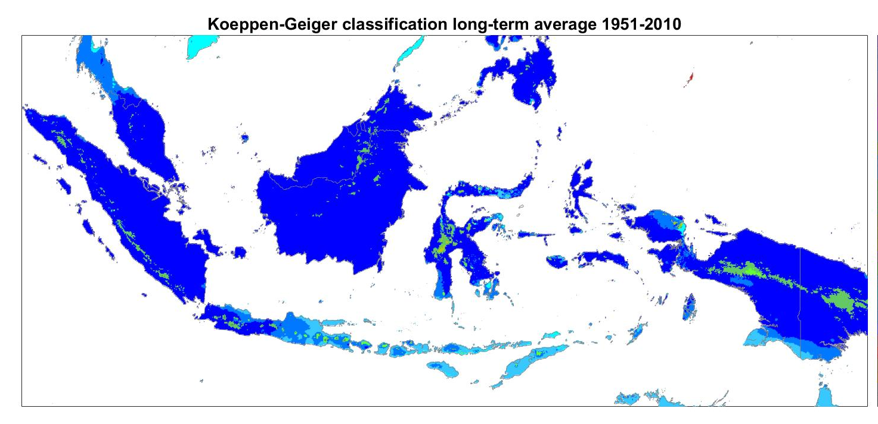
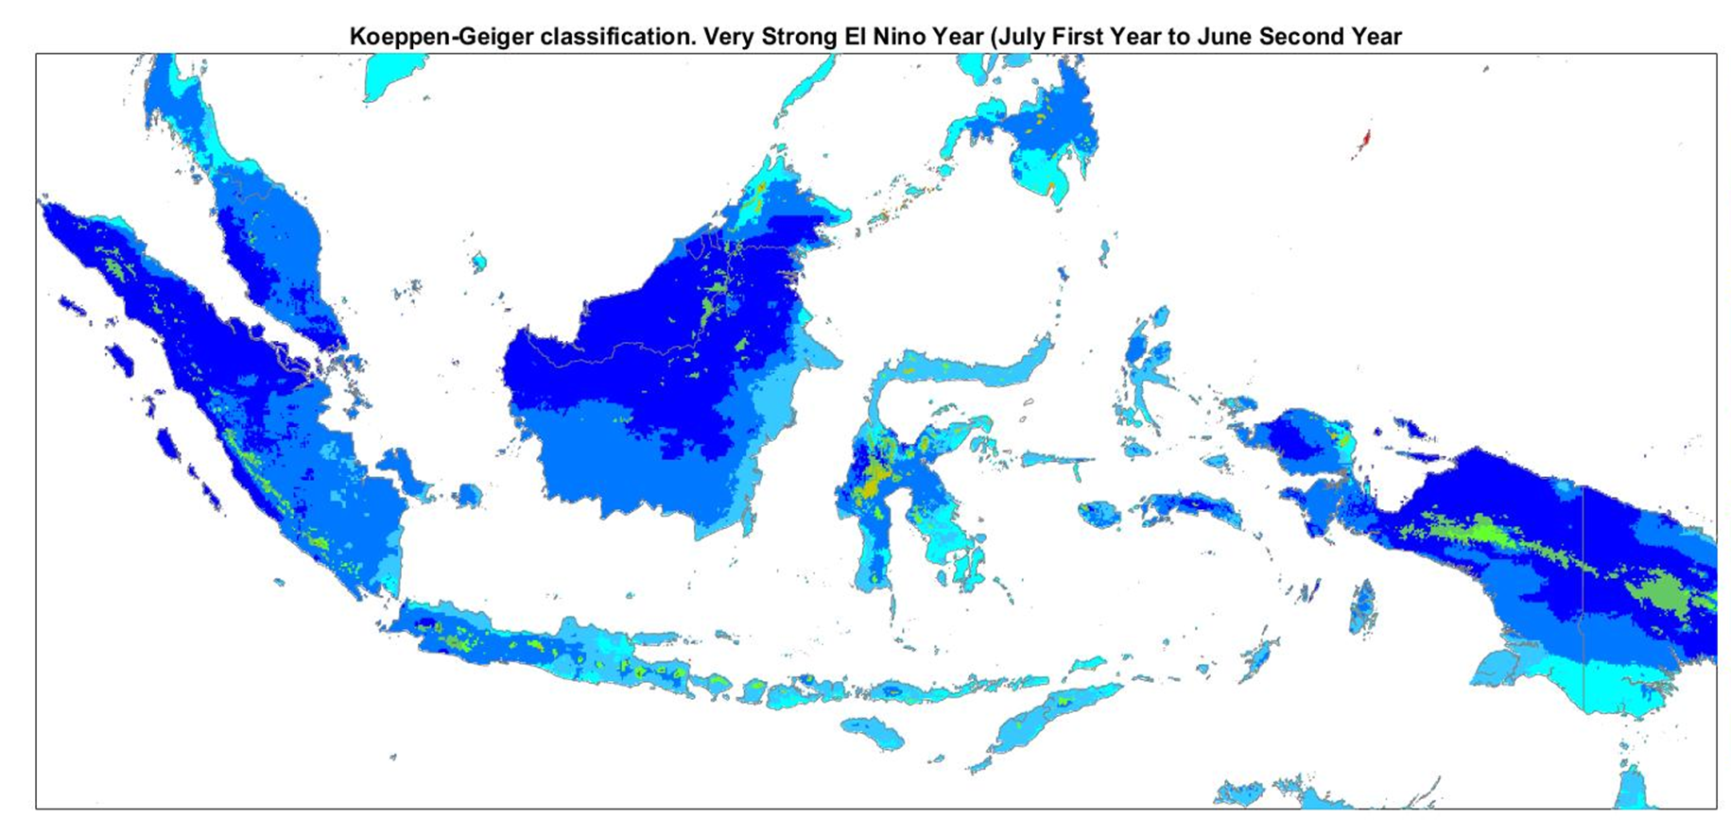
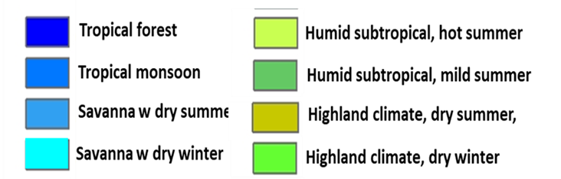
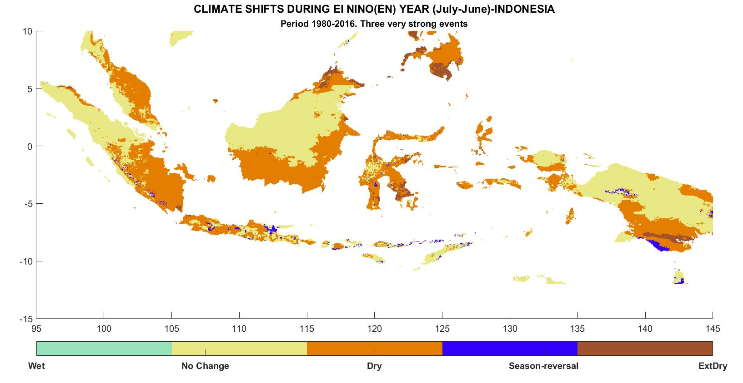
LARGO PLAZO (NORMAL)
AÑOS EL NIÑO
Notes:
To illustrate how it works we are showing here an example with Indonesia using the Climate Hazard Group data base
Indonesia's climate is almost entirely tropical, dominated by the tropical rainforest climate found in every major island of Indonesia, followed by the tropical monsoon climate that predominantly lies along Java's coastal north, Sulawesi's coastal south and east, and Bali, and finally the tropical Savanna climate, found in isolated locations of Central Java, lowland East Java, coastal southern Papua and smaller islands to the east of Lombok. Cooler climate types do exist in mountainous regions.
On the average El Nino event disrupt the rainforest climate in all the majors island particularly in the South of Java, South of Borneo and Celebes, moving to drier versions of the tropical climate, which mean an abnormal seasonal rainfall regime with dry conditions in the rainy season.

Slide 15
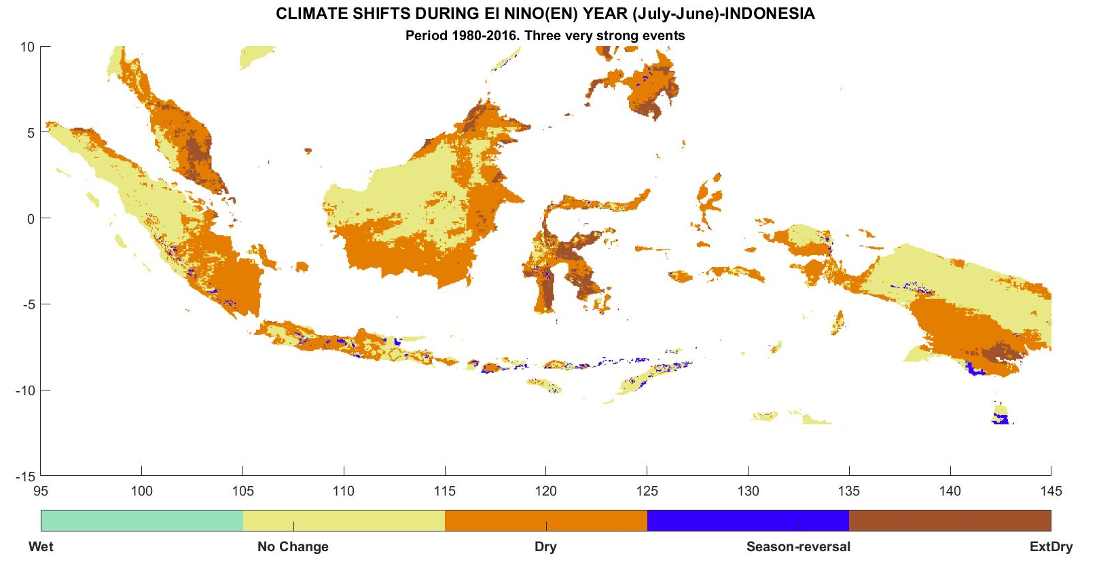
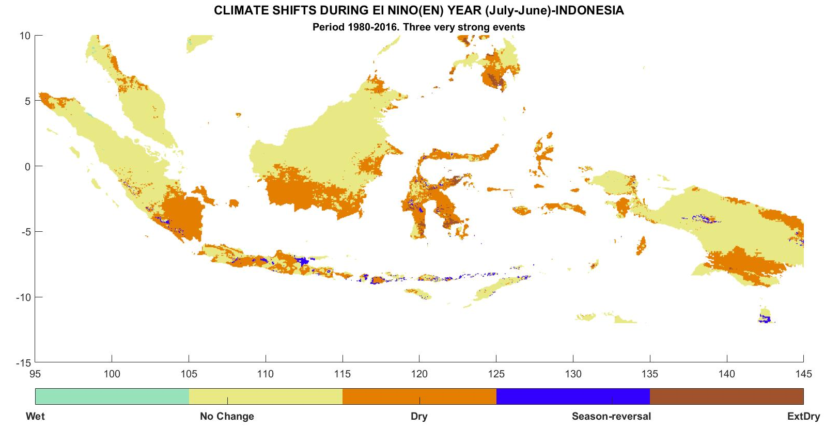
¿Por qué no deberíamos confiar solo en imágenes promedio?
Las interacciones de la teleconexión de El Niño con otros patrones de circulación regional crean una gran variabilidad de los impactos sobre ciertas áreas.
1982-83
1987-88
Por lo tanto, es importante visualizar nuestra incertidumbre en términos de impacto. ¿Dónde los impactos son más esperados?
Para hacer esto, debemos calcular los mapas de frecuencia.
Notes:
Although average El Niño impacts maps are important sources of knowledge and tools for decision makers, they give only a general view about what to expect and sometimes could lead to confusion and miscalculations in DRR activities. This is due not only to the own internal variability of EN event but also to Interactions of El Niño teleconnection with others regional circulation patterns . Keeping Indonesia as an example we are showing at the left a shift in precipitation regime in 1982-83 and in 1986-87 to the right. Although the general pattern of El Nino impact are similar. There are important differences in extension of affected areas and magnitude of the impacts.
So it is important to visualize our uncertainty in terms of impact. Where impacts are more expectable?.
To do this we should calculate the Frequency maps.

Slide 16
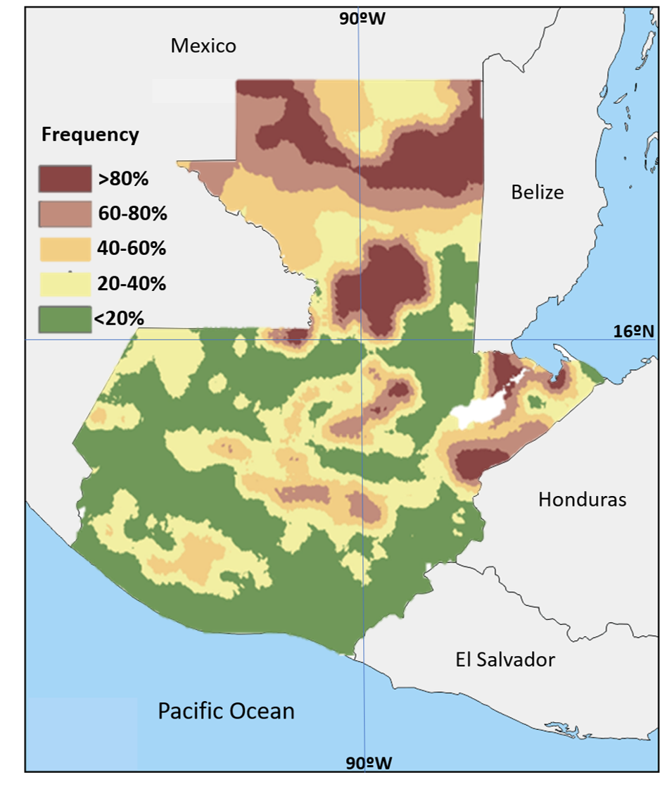
Cálculo de frecuencias
Sti
Numero de años Niño
con cierto tipo de cambio.
1.0. Datos de años individuales de El Niño
1.1. Homogeneización matricial y entrada para el cálculo de Köppen para cada evento individual de El Niño
1.2. Calculo de mapas Köppen y categorias
Fti = Sti/N
2.0. Cálculo de los cambios individuales para años de El Niño
Número total de todos los años El Niño en los datos
3.0. Cálculo de frecuencias y mapas de riesgo
Notes:
The Slide shows a logical diagram of how to construct frequency maps. Basically Steps 1.0 to 2.0 reproduce the processing of the flow chart shown in Figure 3 but considers a year by year basis. That is, the Köppen-Geiger classification is calculated according to each El Niño year individually and then is compared with the long-term average classification to get individual climate shift maps. Once the shifts for individual El Niño years have been calculated, the frequency of different climate shifts can be easily calculated as :
Ft_{i} = St_{i}/N
Where Ft_{i} is the frequency at point _{i} for a shift type t, St_{i} is the number of El Niño Years with a shift type

Slide 17
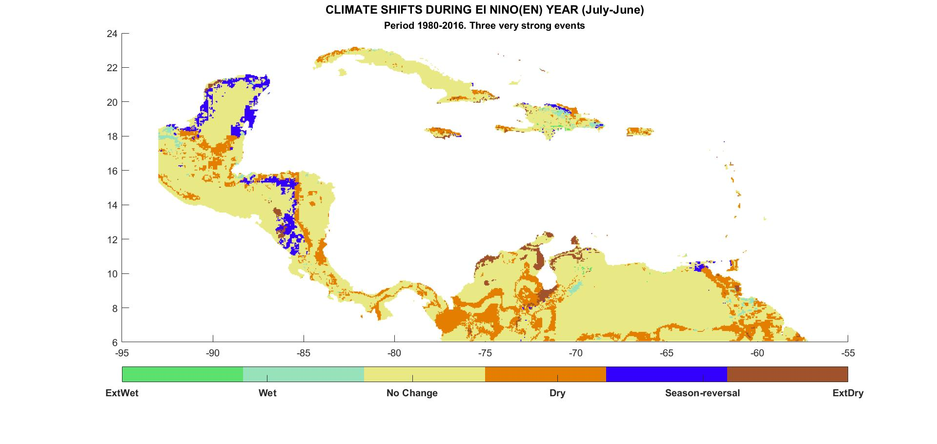
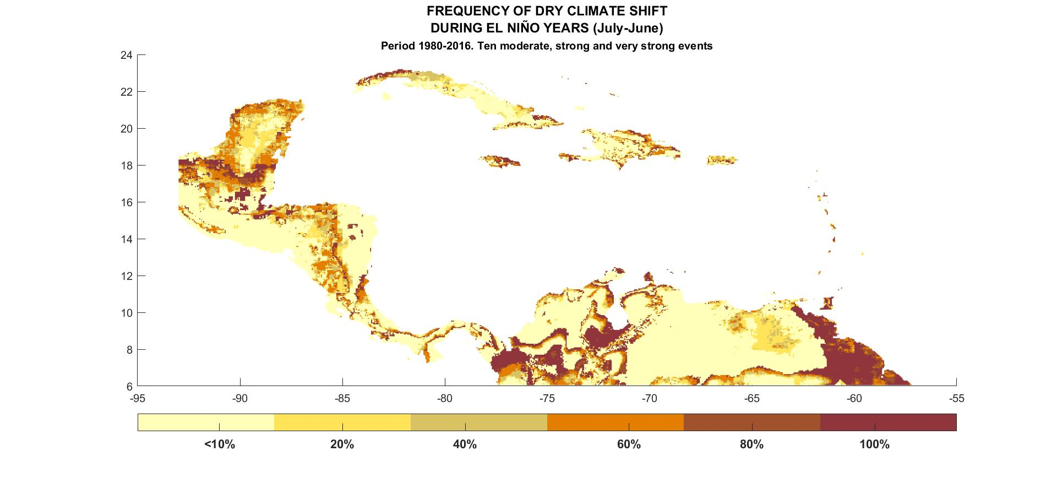
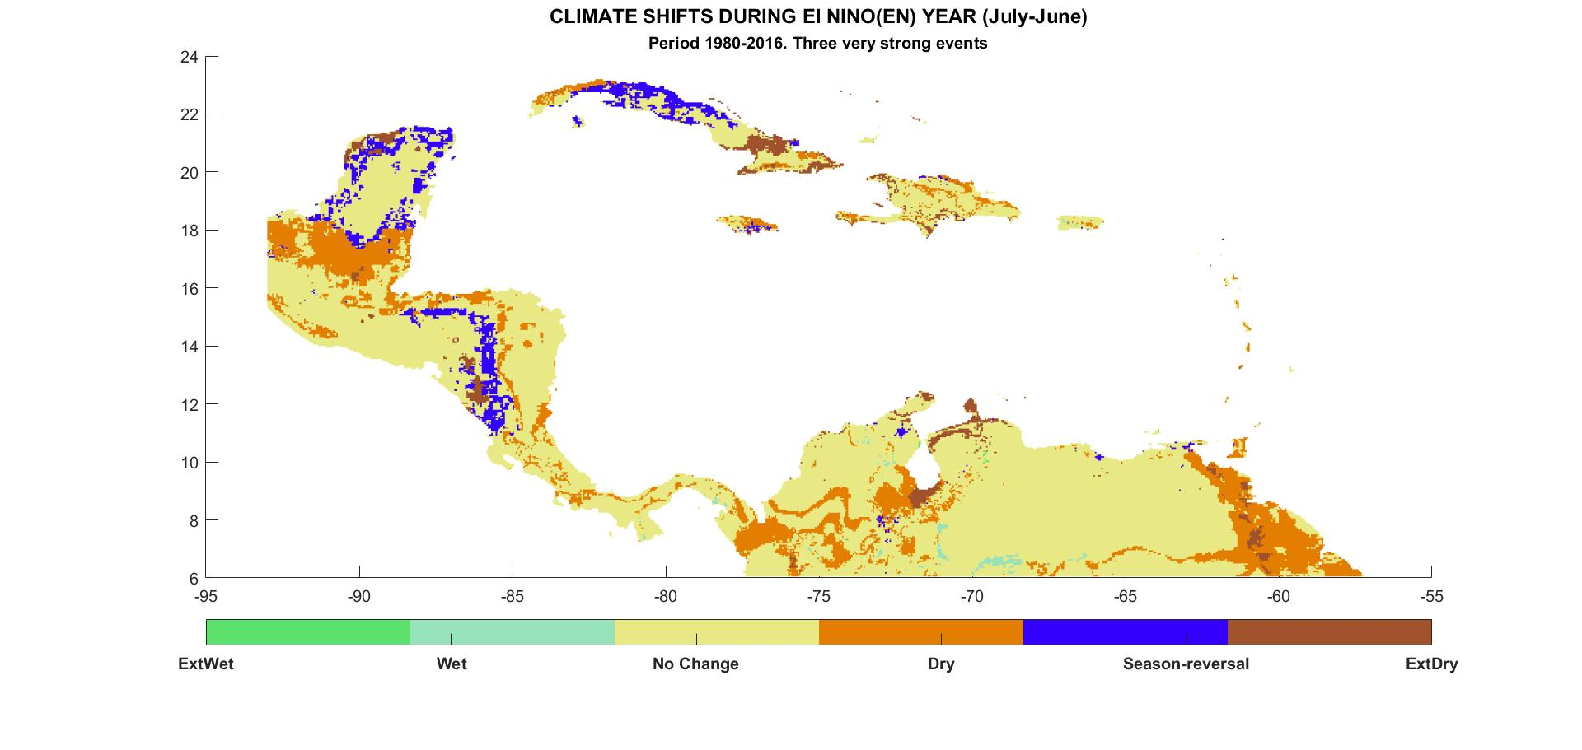
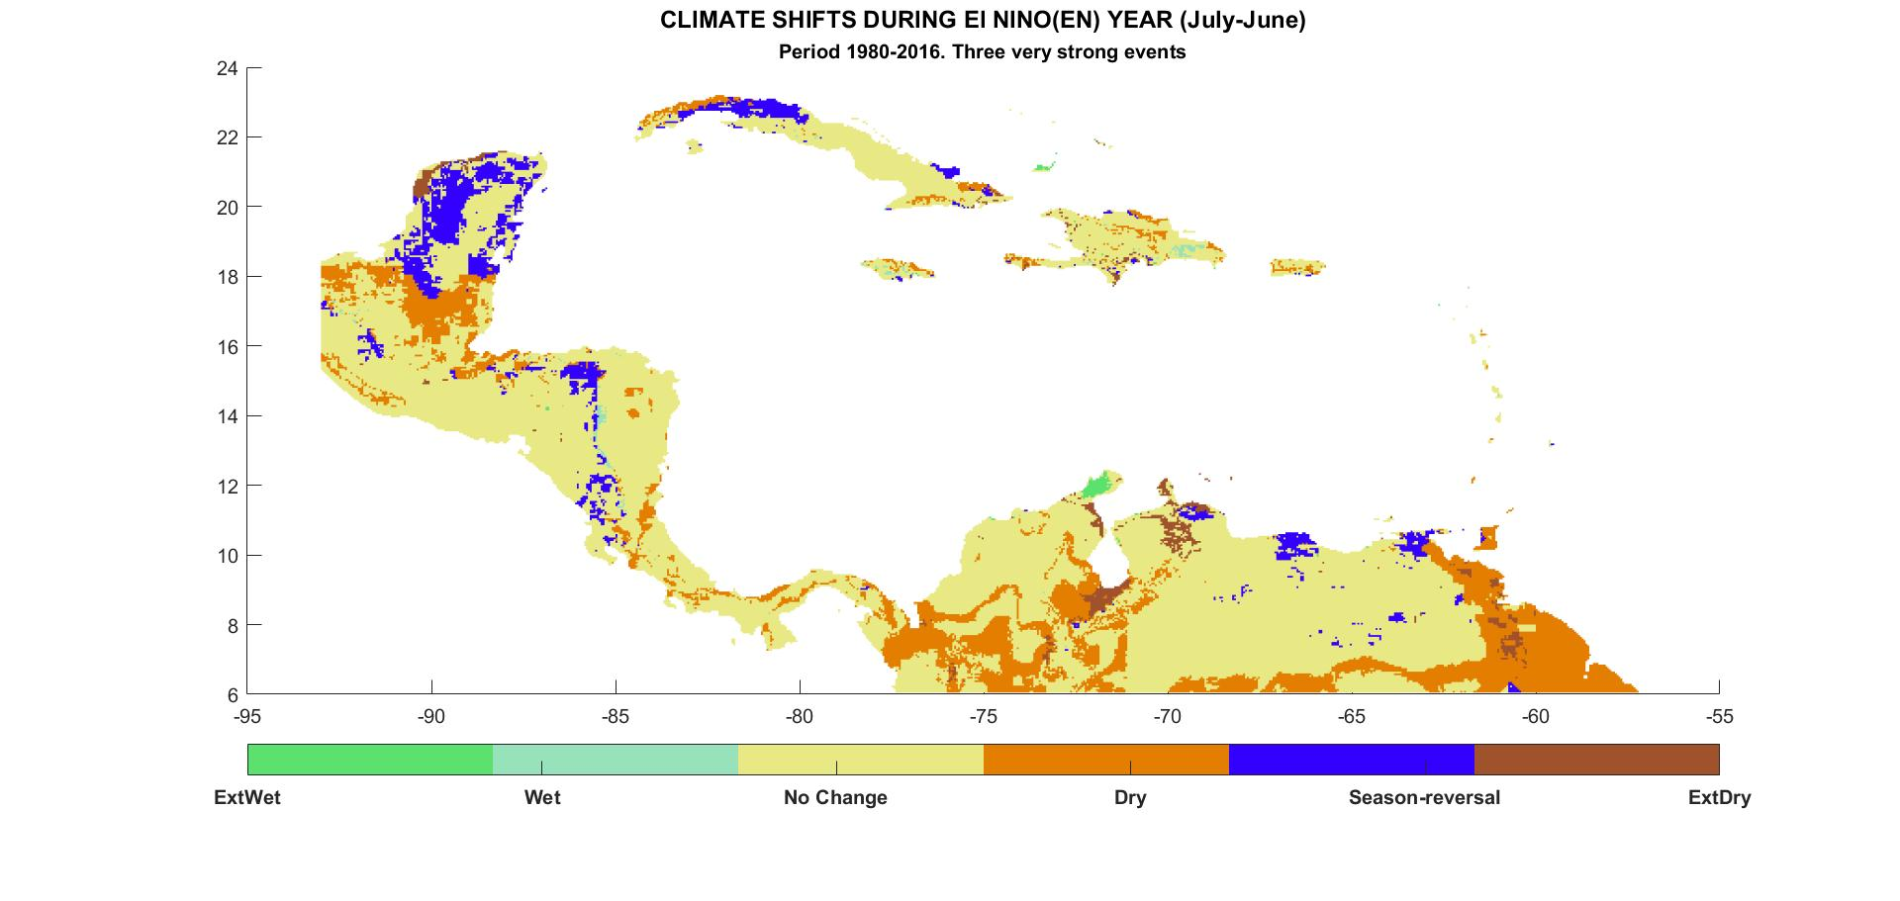
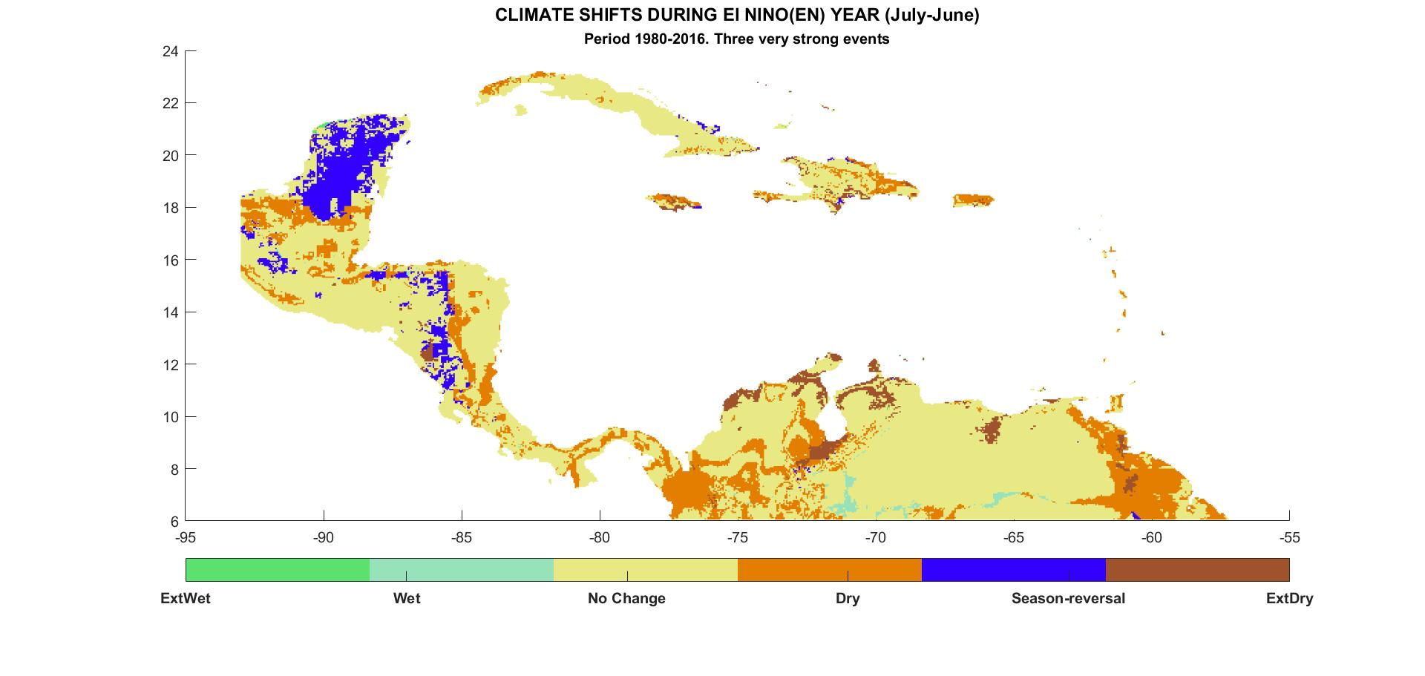
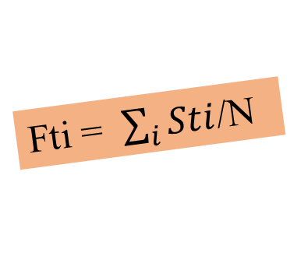
Cálculo de las frecuencias de cambio
Mapas de cambios calculados para cada año de El Niño
matriz de datos
para años individuales
S(2015-16)
S(1991-92)
S(1986-87)
Fti = $\sum_{i}{Sti}$/N
S(1982-83)
Notes:
Although it could be different ways to get derivatives maps; to calculate frequency of impacts and risk maps would give an important tool to policy makers and specialist. To obtain these maps we should process El Niño Years individually to create references of variability.
This step is a little more time consuming because you will need to replicate man times the same processing but results are really encouraging.
To create year to year Köppen maps . For each El Niño year we will performs steps described before in slide taking care that the input matrix will be one El Nino year each time, e.g. [1982], [2015] . The gridded data matrix for each year S(year) should be saved.
Once the year to year calculations is finished, frequency maps and data are calculated for each shift type you want.

Slide 18
¿Por qué es importante un mapa de frecuencia?
Es una herramienta para identificar las áreas más vulnerables.
Es una medida cuantitativa de nuestra incertidumbre en términos de impactos.
PERO además
Los mapas de frecuencia abren la puerta al cálculo de los mapas de riesgo.
Básicamente, una estimación de riesgo en un contexto social puede definirse como el "producto del daño esperado en un escenario ... y la frecuencia de este escenario"
RIESGO = ESTIMADOR DE DAÑO * FRECUENCIA DE ESCENARIO
en su forma más simple, el mapa de frecuencia en sí podría considerarse una medida de riesgo
Combinando esta información con otras, como el costo del daño, los niveles de infección de una enfermedad o simplemente la gravedad del peligro, podemos construir diferentes mapas de riesgo.
Notes:
Why a frequency map is important?
It is a tool to identify the more vulnerable areas
It is a quantitative measure of our uncertainty in term of impacts
BUT also
Maps of frequency of dry/wet impacts open the door to the calculation of risk maps.
There is different way to calculate a risk map. Basically a risk estimation in a social context represents the damage or the fatalities that are statistically expected due to the hazard impact in certain scenario. So, Societal risk can be defined as the “product of the expected damage in a scenario…and the frequency of this scenario”.
In the context of El Niño, societal risk is the potential economic and population losses that are anticipated with the forecast of a warm event and its related anomalies (e.g., floods and droughts).
in a simplest form, the frequency map itself could be considered a measure of risk, otherwise if we combine this information with other such as cost of damage, levels of a disease infection or simply severity of the hazard we can construct different risk maps.

Slide 19
Procedimiento
Diseñamos un paquete de procesamiento en MATLAB:
Lectura y procesamiento de datos
read_multiple_temp.m
read_multiple_precip.m
read_multipleraster_temp.m
read_multipleraster_prec.m
Cálculo de los mapas Koeppen Combine.m
classKoppenNN.m*
classKoppenEN.m*
* Debe ejecutarse en el toolbox de Meteolab
Frequencias y Cambios
difference.m
risk.m
El paquete de procesamiento es accessible en : https://bit.ly/2v6fmZS incluye un documento pdf con una "Guía"
Estas NO SON recetas. Para la aplicación a áreas o condiciones específicas, los parámetros deberán ajustarse y modificarse dadas las circunstancias específicas. Debe abordar esta metodología con una perspectiva creativa..
Notes:
To obtain our results we designed scripts that can be classified in 3 groups Input and processing data, Calculations of Koeppen Maps and calculations of shifts and frecuencias. Everybody can access these scripts in the web address I am provided in the slide. Additionally there is PDF document as a “Guidebook” to help and clarify our methods.
It is important to be clear that these ARE NOT recipes to be used without changes. Some parameters had to be modified according each specific circumstance. You should understand every step and be creative.

Slide 20
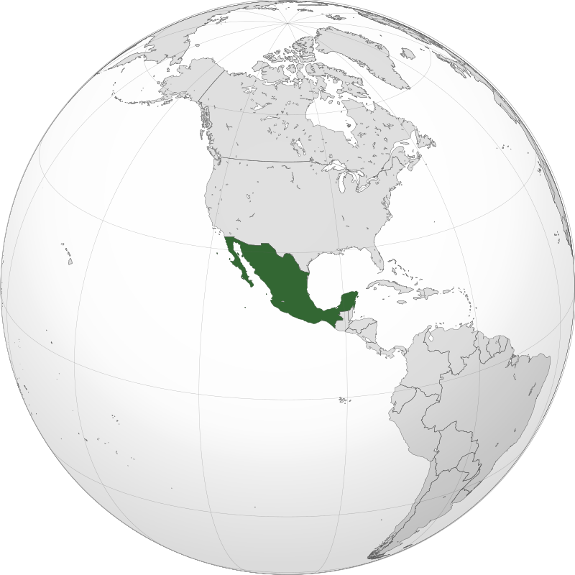
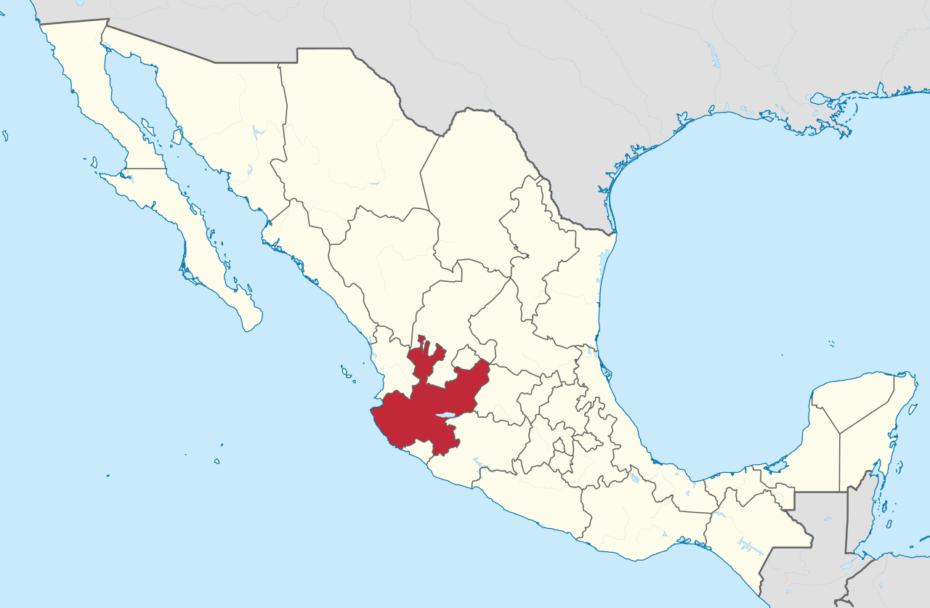
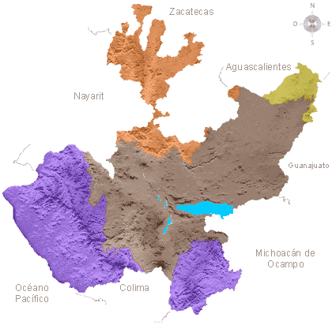
Un ejemplo de escala subnacional: Jalisco
Jalisco, es uno de los treinta y un estados que forman los Estados Unidos Mexicanos. Con 8,783,830 habs. en 2018 es el tercer estado más poblado.
El relieve es predominantemente montañoso, con ausencia de llanuras. En Jalisco convergen cuatro de las más grandes formaciones topográficas de México: la Sierra Madre Occidental, la Sierra Madre del Sur, el Eje Neovolcánico y la Mesa del Centro.
*https://www.gob.mx/cms/uploads/attachment/file/432100/Jalisco.pdf
Notes:
Guatemala, the most populous country in Central America with over 16 million habitants but high rates of poverty. National economy is dependent of agriculture and droughts are a risk factor for food security: subsistence farmers are the most vulnerable. The United Nations Organization for Food and Agriculture (FAO) estimated that during the 2015-16 El Niño more than 1 million families depended on subsistence agriculture in Central America.
1. Important areas of the country are located in the called “Dry Corridor” with high levels of poverty. “Dry Corridor” is a region defined by a group of ecosystems that exists in the dry tropical forest of Central America. It extends across Guatemala, Honduras, Salvador, and Nicaragua. It is a stressed area in terms of rainfall that is characterized by a well-marked dry season from December to April. Drought in the region is mostly related to below average precipitation during the rainy season and a so called annual mid-summer drought known as canicula, which is an intraseasonal period of relatively dry conditions in the middle of the rainy season in July and August .

Slide 21
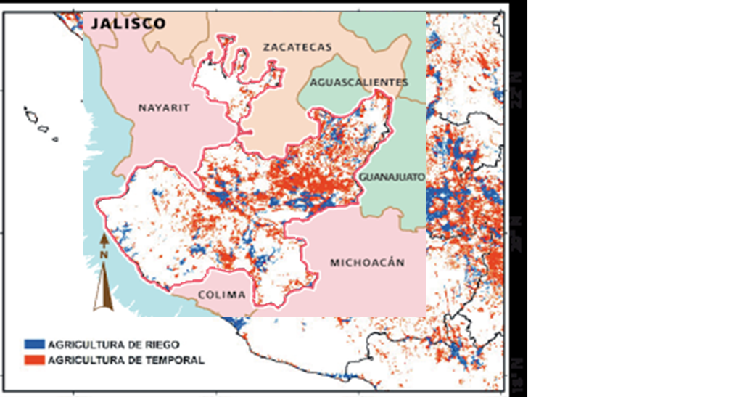
La relevancia de la actividad agrícola en Jalisco es alta debido a que de la superficie total del estado, el 21% de la superficie total presenta vocación para las prácticas agrícolas productivas. De este total el 83% se aprovechan bajo condiciones de temporal
De 0% a 40%
De 40% a 50%
Más de 50%
Mas de 2 millones de personas viven por debajo del del nivel de pobreza*

Slide 22
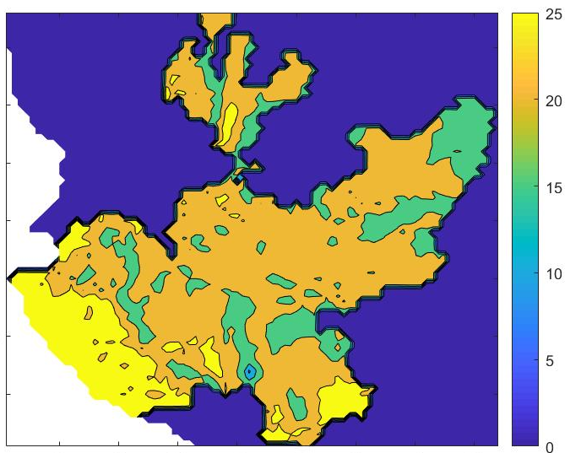
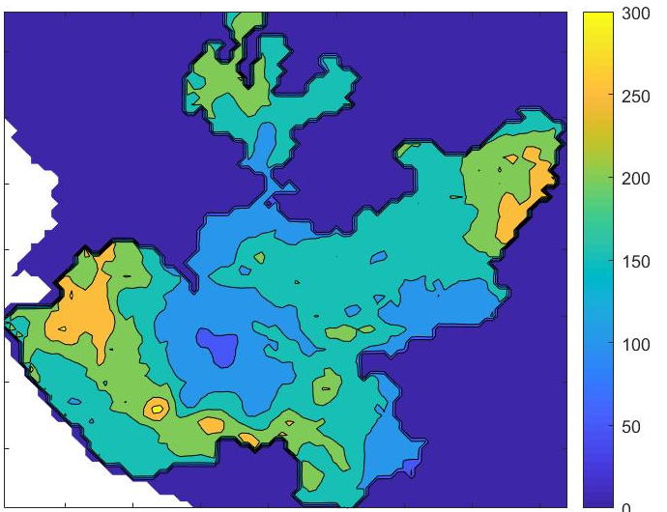
Datos a usar: Un gran desafío es que casi todos los conjuntos de datos mundiales a largo plazo tienen resoluciones que a escala regional, nacional y subnacional parecen demasiado bajas. Debemos tener en cuenta que, dado que El Niño tiene una frecuencia de varios años, no solo necesitamos conjuntos de datos confiables sino también lo suficientemente largos.
Transformed Temp Data ( 0.05 degree)
Precip CHIRPS Data ( 0.05 degree)
Utilizamos las estimaciones de precipitación Grupo de riesgos climáticos (CHIRPS) Desde 1981 hasta el presente, CHIRPS incorpora imágenes satelitales de resolución de 0.05 ° con datos de la estación in situ para crear series de tiempo de lluvia cuadriculadas.
Notes:
IN this case the National Met service in Guatemala developed a very high resolution and reliable data base of Montlhy Mean Temperatures ( about 500 meters of resolution). Although they have been working in similar data for precipitation we decided to use the precipitation data of the Climate Hazard Group (CHIRPS) version 2.0. So we needed to homogenize the temperature data to a lower resolution and a same grid point to about 5km resolution.

Slide 23
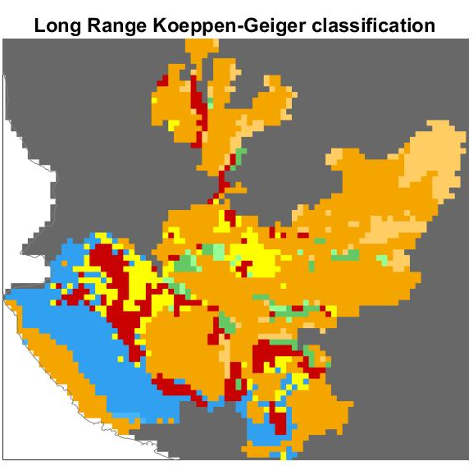
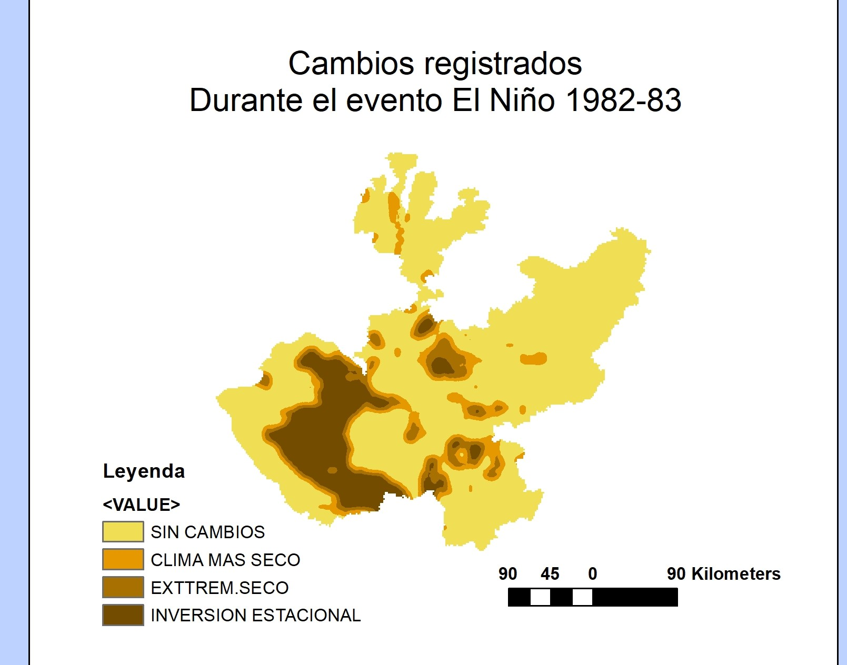
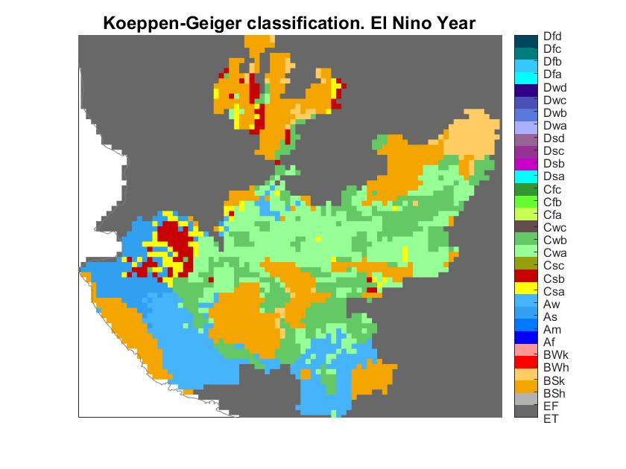
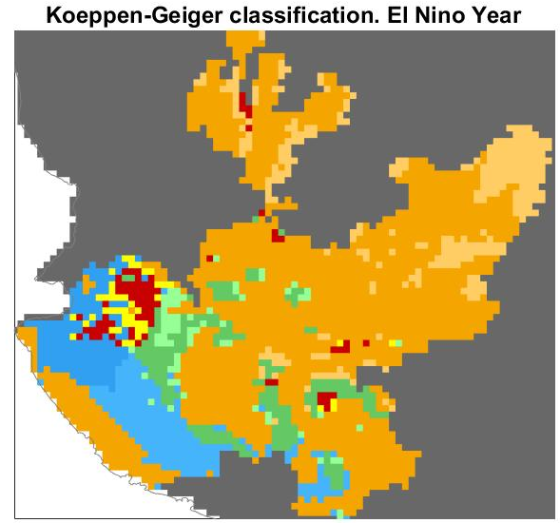
Cálculo de mapas de Köppen.
Como primer paso, es necesario calcular dos mapas de Köppen: un mapa de Köppen “Normal” y mapas de El Niño Köppen.
Notes:
This slide shows the long-term average of the Koppen-Geiger climate classification for Guatemala for 1980 to 2016 the “Normal” (left) and El Niño-related climate shifts during El Niño years (right).
As mentioned earlier, these shifts can be categorized according to the “direction” and intensity of the change .
Strong changes in the climate patterns during El Niño are evident. The deep blue areas, which correspond with very humid climate (Af), tend to disappear while the orange areas, which correspond with semi-arid conditions (Bsh) increase in spatial extent over most of the interior mainly over the important Rio Motagua Basin. In the rest of the country, normal climate configurations emerge towards new classes characterized by the predominance of drier climate types.

Slide 24
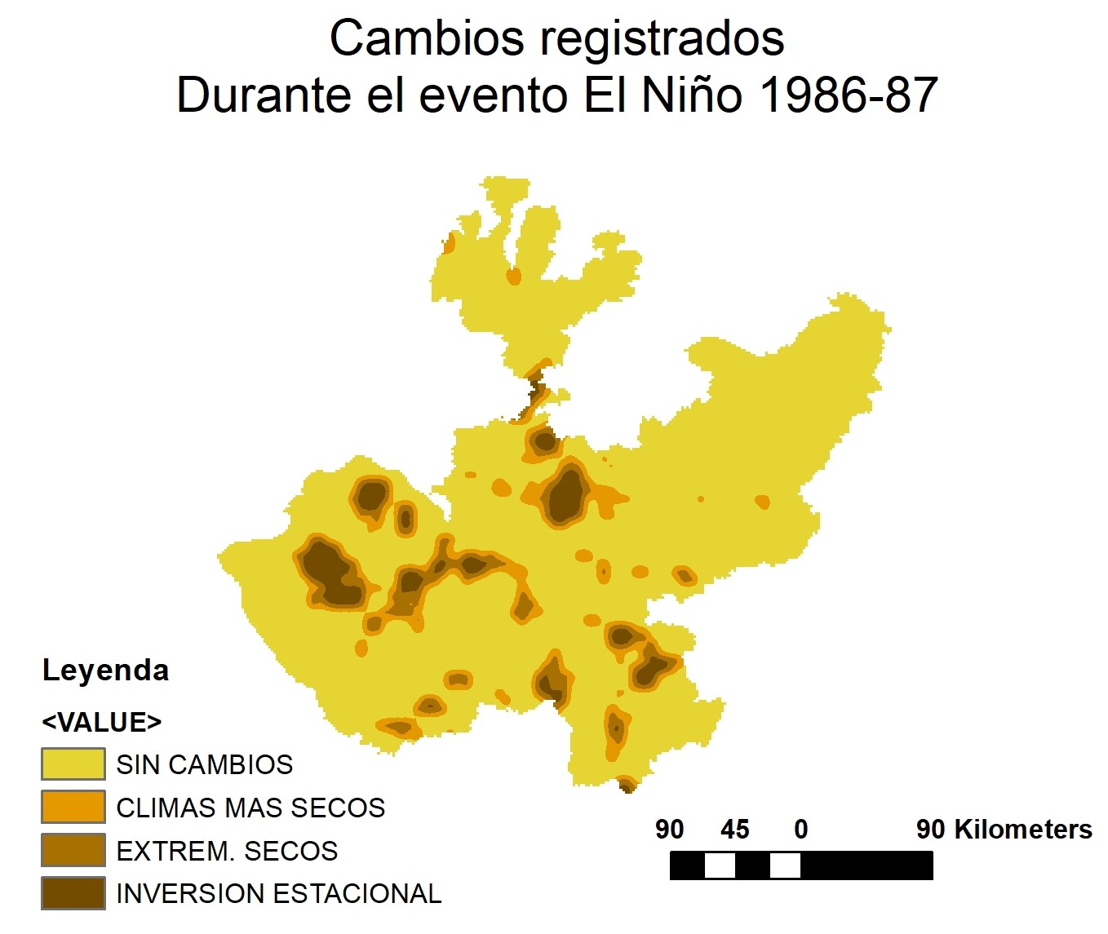
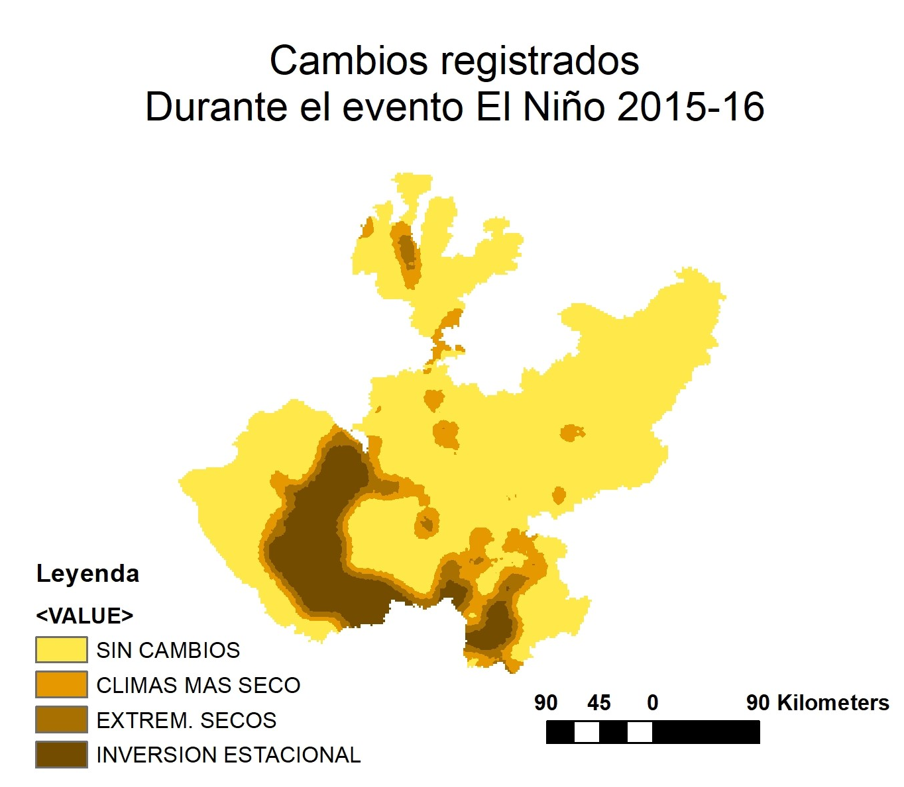
1982-83
1986-87
2015-16
Los promedios deben considerarse como una visión suavizada de los mapas reales. Analizando el comportamiento "evento por evento" podemos describir la variabilidad temporal de los impactos y obtener información sobre el nivel de exposición, la zona más sensible y otra información adicional útil para la planificación de RRD.
Notes:
However, averages should be considered as a smoothed vision of the real, therefore, it would be strongly recommended to analyze the “event by event” behavior to consider the time variability of the impacts and get information about level of exposure, more sensible zone and other additional information useful for DRR planning. Results of analyzing individually each El Niño event, indicate that although there are variations in the magnitude of the affected areas, the general structure of the average maps is highly consistent.

Slide 25
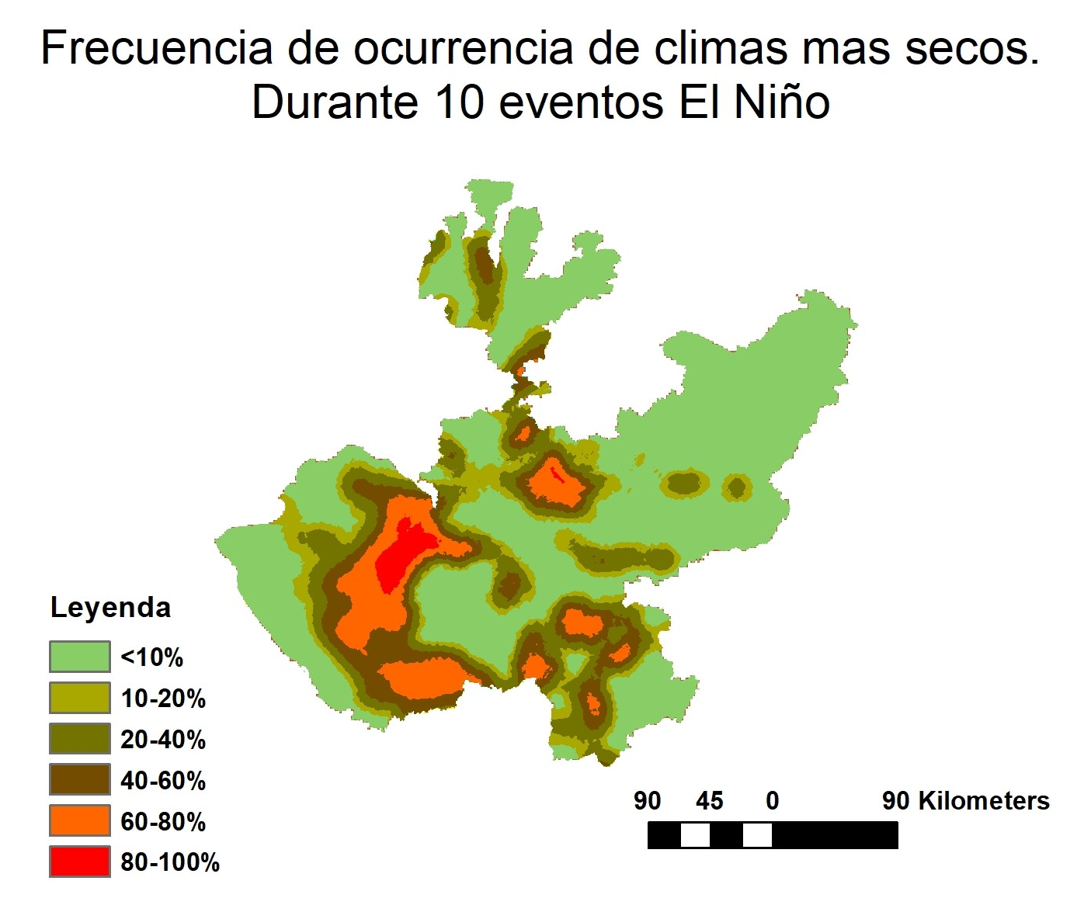
Calculando las frequencias
Diseñamos el script "risk.m“ para calcular el mapa de frecuencias de cambio a un clima más seco. No se encontró ningún cambio a "más húmedo".
Este mapa representa una imagen más realista de los impactos esperados de El Niño y su variabilidad espacio-temporal. Muestra la frecuencia de los cambios climáticos relacionados con El Niño, que es una medida del nivel de exposición de los impactos más significativos sobre el clima (y, en consecuencia, sobre los ecosistemas y la agricultura)
Los impactos mas persitentes se observan sobre las zonas altas de la Sierra Madre del Sur y en la zna de la capital Guadalajara, siendo mas variable en el resto del Estado.
Notes:
Using the script “risk.m” we calculated the map of frequencies of shift to a drier climate. No shift to “wetter” was found.
This map represent a more realistic picture of expected El Niño’s impacts and its spatio-tempral variability. It shows the frequency of El Niño-related climate shifts which is a measure of the level of exposure of the more significant impacts over climate ( and consequently over ecosystems and agriculture
There are some important characteristics, in a sub-national level. For example, in the northern part of the country there are more persistent impacts due to the El Niño effect over the Tropical forest and Monsoon climate while in areas of the Dry Corridor impacts seem more variable BUT indicating a relatively high frequency of climate shifts. The combined use of figures can offer usable information, determining where foreseeability of drought or other drier conditions are higher among others.

Slide 26
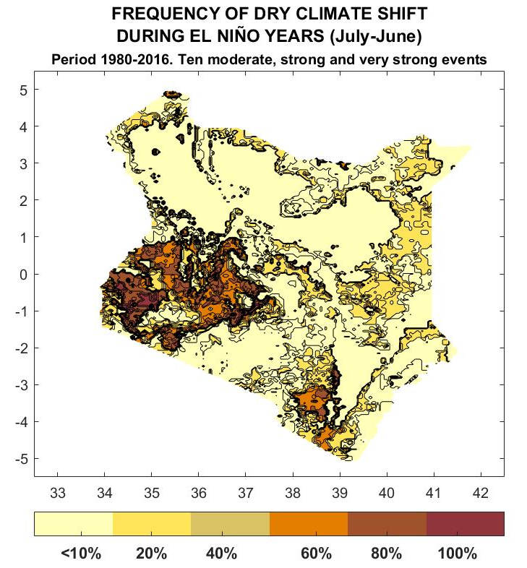
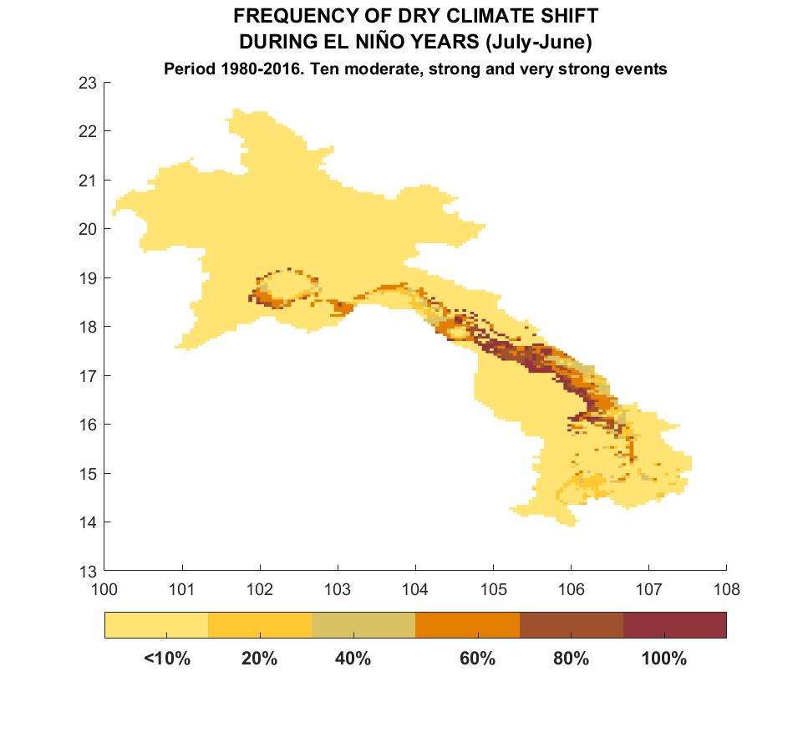
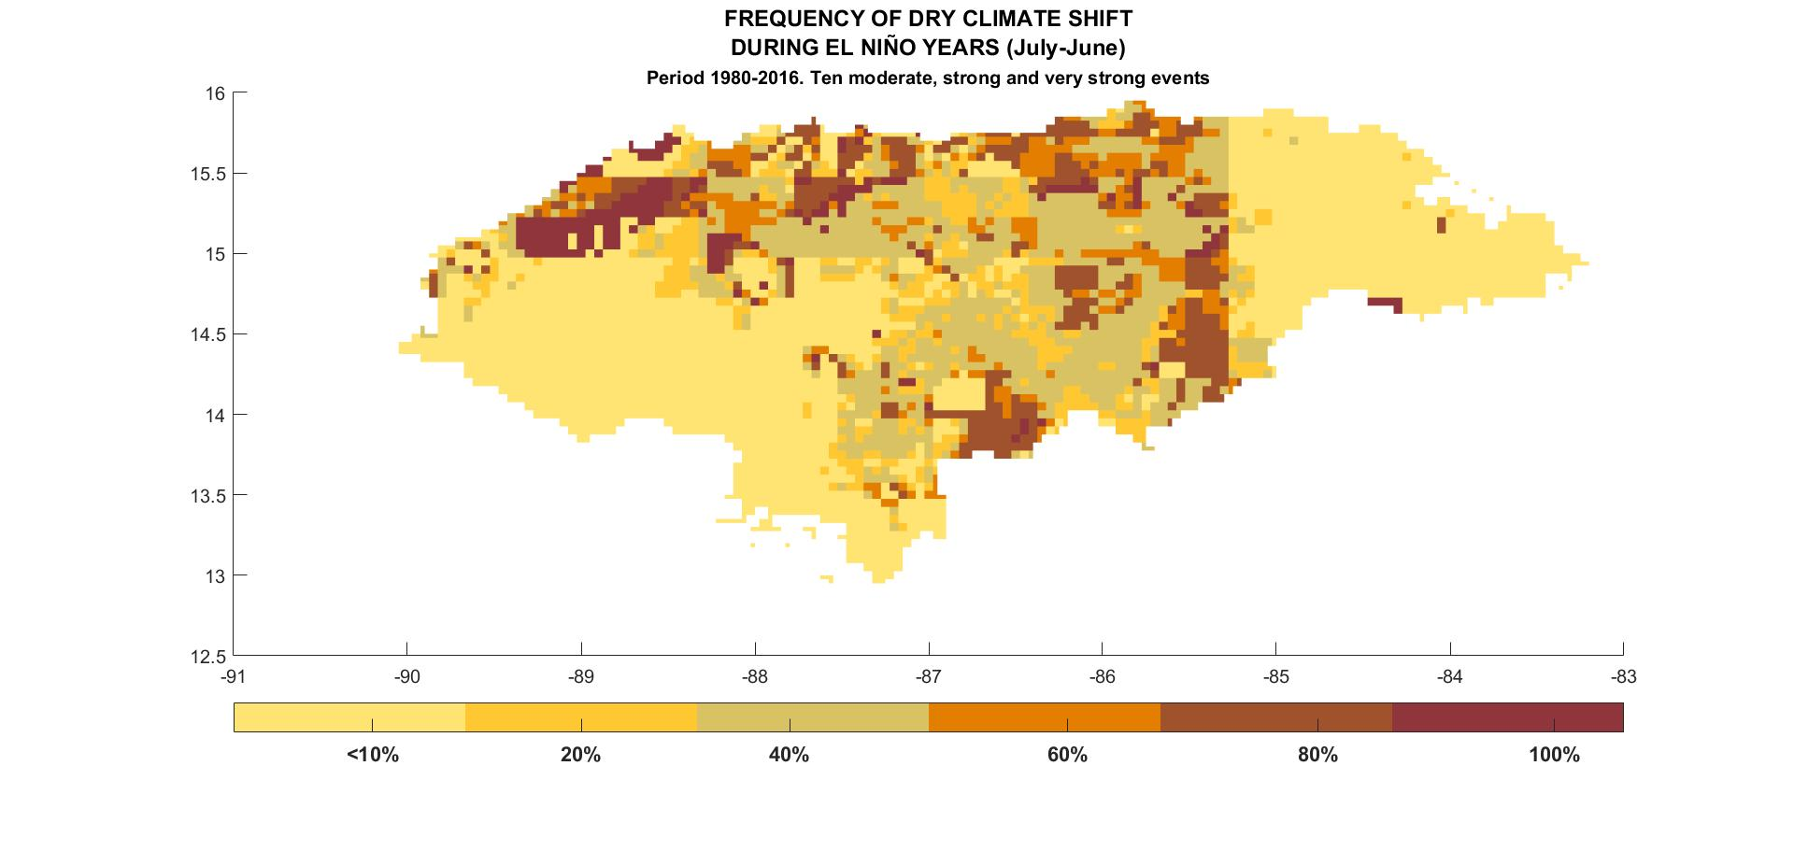
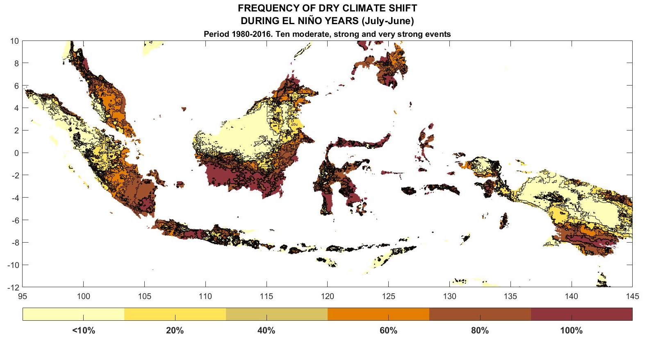
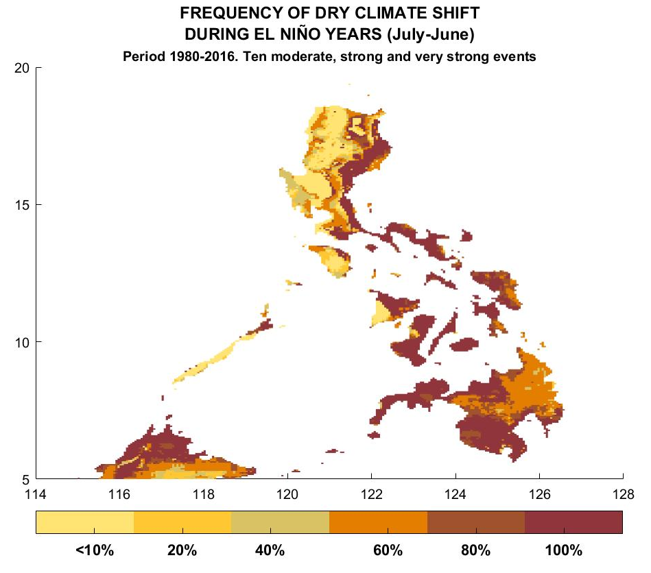
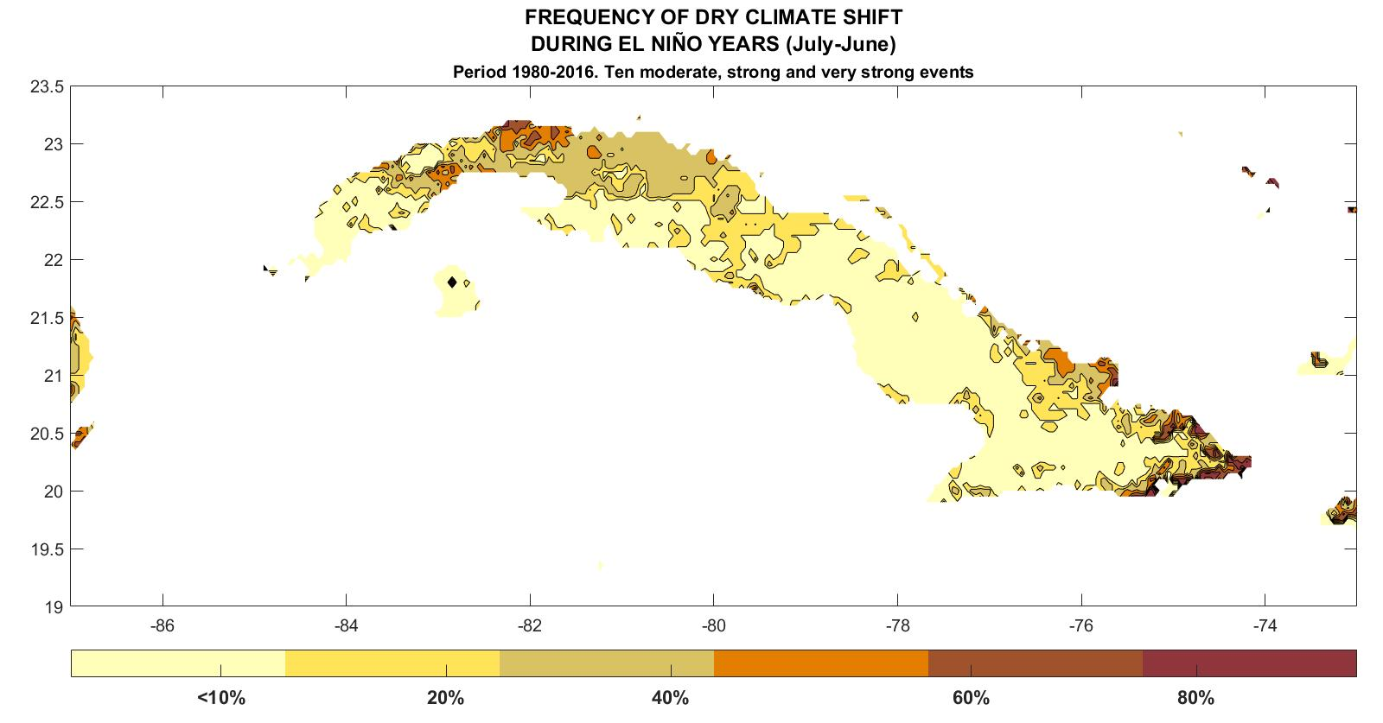
Actualmente tenemos resultados preliminares para varios paises y regiones:
Central America and Caribbean
Kenya
Laos
Honduras
Indonesia
Philippines
Cuba
Notes:
During this time we have been working to get some results in others countries with the basic objective of testing. See if result are consistent with the real. In some cases as in Guatemala, Philippines and Kenya we had the opportunity to interact with national specialist. We are putting all the information freely with the methodology for all NHMSs interested.
The question is. Why we are not designing a global map? One answer is due the data base availability but the most important is we still have to determine the geographical dominion where this method is consistent and viable.

Slide 27
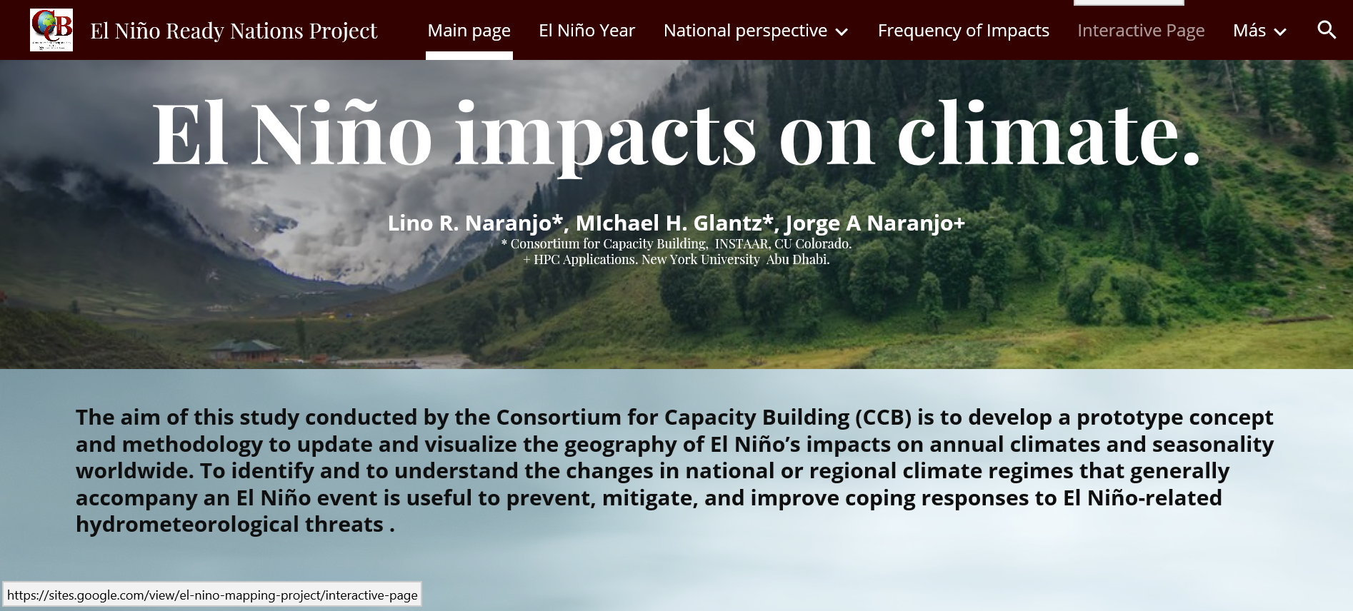
Puede acceder a todos los resultados y a una explicación detallada del método en:
https://sites.google.com/view/el-nino-mapping-project/home
Notes:
This page was designed to share our results freely, It is composed by some sections or windows with different subject. (definition of El Nino year, results of National studies, frequency maps, etc. and a interactive page for visualize frequencies.

Slide 28
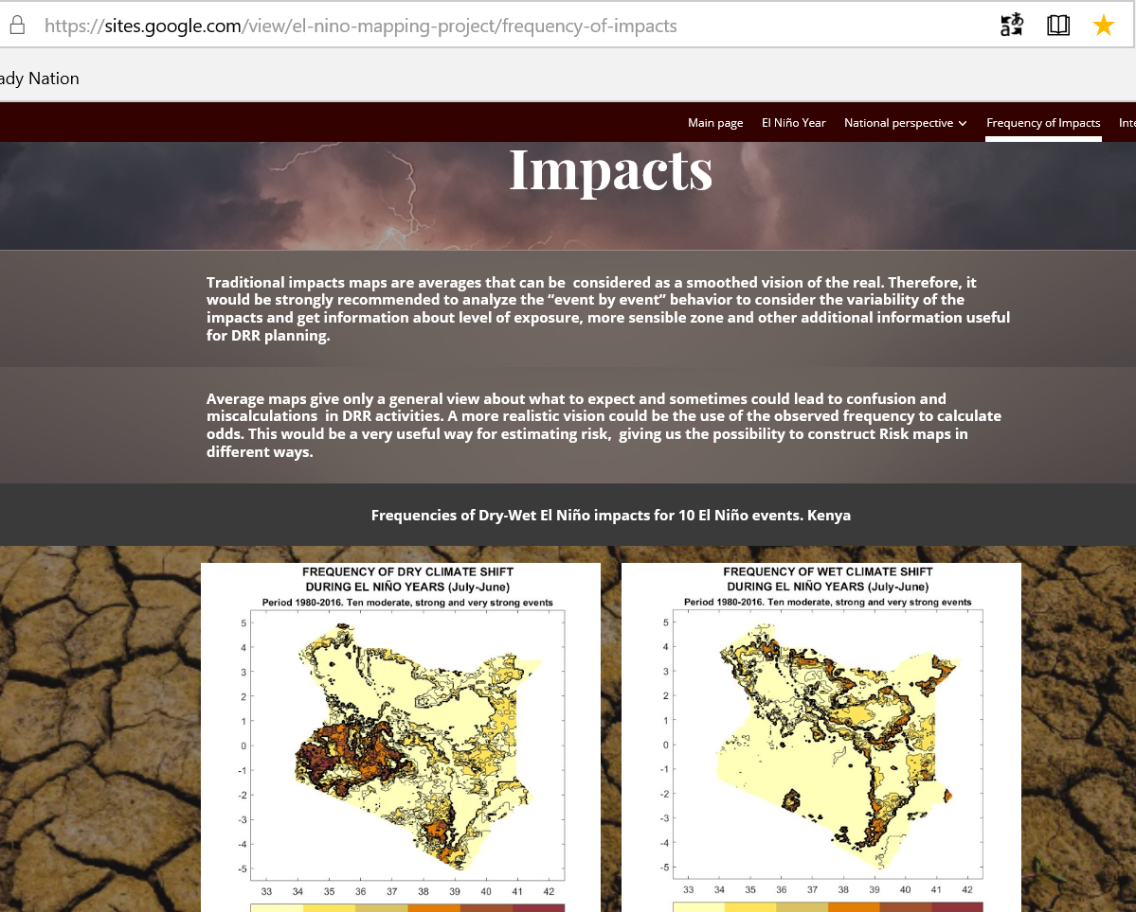


Slide 29
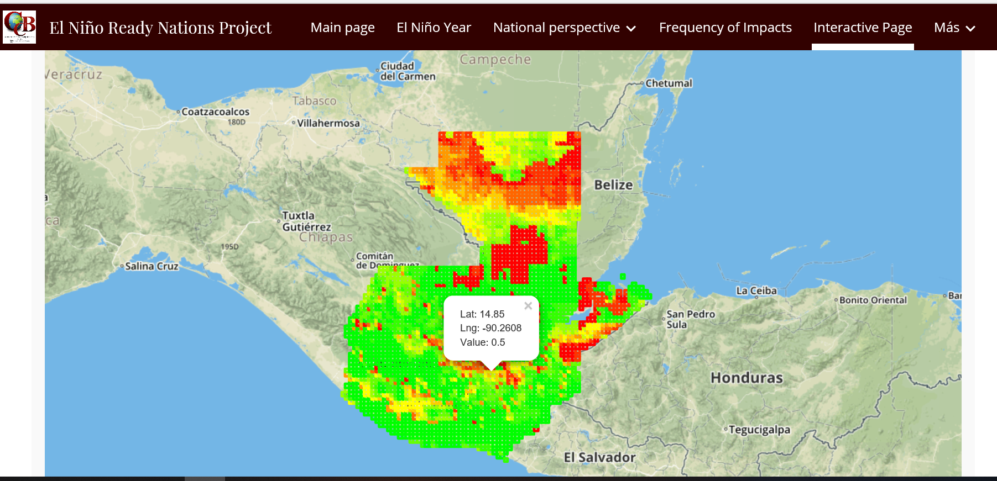
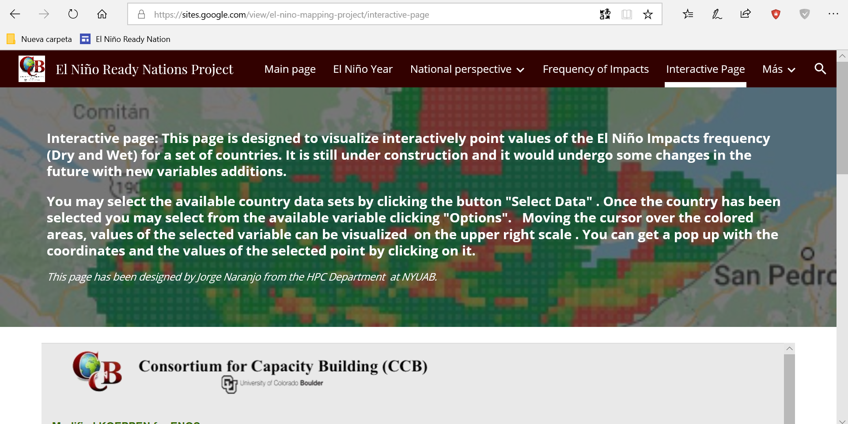
Actualmente estamos trabajando en el diseño de una página interactiva
Notes:
We are designing an interactive pages in cooperation with personal of the New York University of Abu Dhabi. You will get the information about frequency by clicking over the map. It is still under construction but we expect be fully operative soon.

Slide 30
Aunque estos resultados deben considerarse como preliminares, son los primeros mapas realistas de impactos de El Niño aplicados a una perspectiva nacional con una aplicación directa para DDR
Identificar cómo cambia el esquema de clasificación de Köppen-Geiger proporciona información sobre la dirección y las magnitudes de estos cambios. Los impactos se vuelven "cualitativamente medibles".
Proporciona información sobre la variabilidad espacial de los impactos a nivel subnacional basado en datos mensuales de precipitación y temperatura.
El análisis de los eventos individuales visualiza cómo cambia la estructura espacial y diseña mapas de frecuencia que abren la puerta al cálculo de mapas de riesgo.
Las herramientas de procesamiento fueron diseñadas de tal manera que pudieran reproducirse en otros países con la capacidad de desarrollar conjuntos de datos de alta resolución.
Notes:
Although these results should be considered as preliminary, they seem to be as the first realistic El Niño impacts maps applied to a National perspective with a direct application for DDR planning efforts., they reflect indeed the most significant consequences of El Niño in terms of social and economic impacts, accounting the effects of the climate anomalies generated by El Niño teleconnection patterns with devasting and long lasting consequences over agriculture, health and human welfare.
Our approach has important innovative characteristics such as being comprehensive giving information not only about the direction of change in climate regime but also about their magnitude. The maps reflect the spatial variability of the impacts in a sub-national level and it is capable to account their intrinsic time variability. Calculating, analyzing and comparing individual events permit us to visualize how the spatial structure change and to design frequency maps of dry-wet impacts opening the door to the calculation of risk maps.
Processing tools were designed in such a way that it could be reproduced in other countries or regions with a capability to develop high resolution data sets. As the resulting field are gridded data, they are able to be assimilated in GIS.

Slide 31
Nuestra metodología tiene potencial para los esfuerzos de planificación de RRD, sin embargo, todavía hay margen de mejora
Se podrían obtener resultados más precisos si se contara con datos mas fiables de temperatura y precipitación de alta resolución.
Los mapas de impacto no deben considerarse como totalmente exhaustivos, ya que no tienen en cuenta esos impactos que no presentan una influencia perceptible sobre la estacionalidad. Sin embargo, reflejan las consecuencias más significativas de El Niño en términos de impactos sociales y económicos.
La utilidad de nuestro enfoque para países con impactos remotos, como los de latitudes medias, aún debe determinarse. Nuestro enfoque debería ser más efectivo en lugares donde los impactos de El Niño afectan claramente el régimen estacional normal.
Notes:
While this approach and methodology has potential for DRR planning efforts, there is still room for improvement. Firstly, the more accurate results could be obtained, if reliably measured high-resolution precipitation and temperature data were available, which unfortunately is very unlikely in the near future for most El Niño hazards-prone countries. Secondly, we did not take into account El Niño-related impacts without a discernible influence over seasonality, such as isolated events or other marginal impacts that may not affect the normal seasonal behavior of a region. Therefore, in countries with remote impacts, such as those in middle latitudes, the utility of our approach has yet to be determined. The CCB Köppen-Geiger-based maps are most effective in places where El Niño-related impacts (drought, heavier rains than normal in the rainy season) clearly affect the normal seasonal regime.
Put all this information in an accessible, reliable and fast way to user is crucial to fulfill the urgent need, at different levels, to improve the efficiency of DRR plans.

